Slide 1

Java™ How to Program, 9/e
© Copyright 1992-2012 by Pearson Education, Inc. All Rights Reserved.

Slide 2
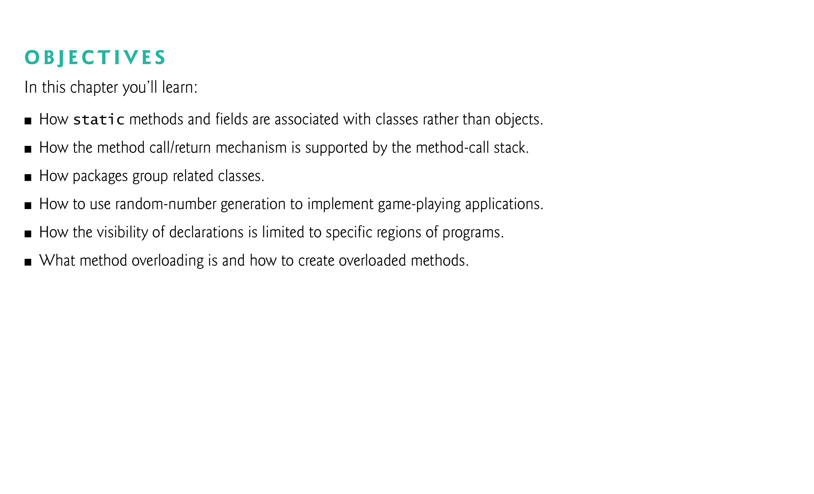

Slide 3
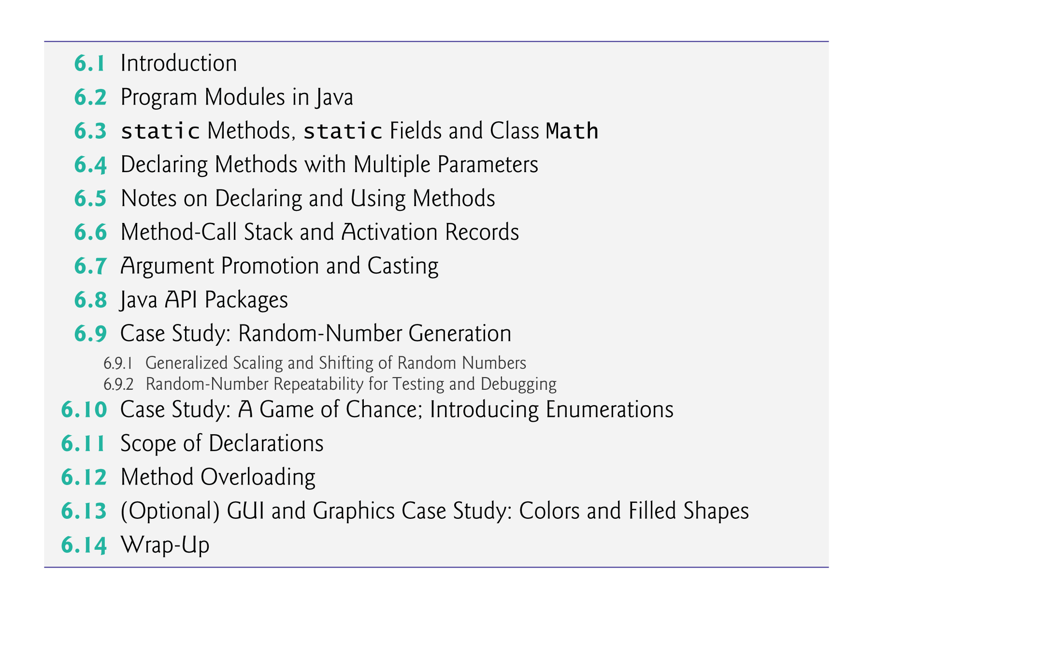
© Copyright 1992-2012 by Pearson Education, Inc. All Rights Reserved.

Slide 4

Best way to develop and maintain a large program is to construct it from small, simple pieces, or modules.
  divide and conquer.
Topics in this chapter
  static methods
  Declare a method with more than one parameter
  Method-call stack
  Simulation techniques with random-number generation.
  How to declare values that cannot change (i.e., constants) in your programs.
  Method overloading.
© Copyright 1992-2012 by Pearson Education, Inc. All Rights Reserved.

Slide 5
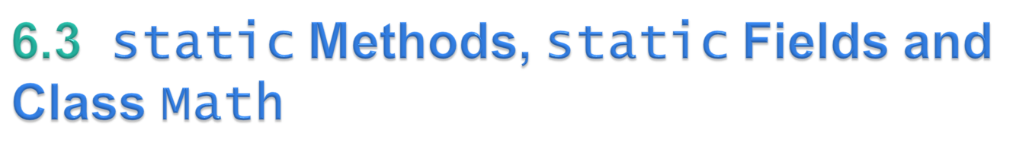
Sometimes a method performs a task that does not depend on the contents of any object.
  Applies to the class in which it’s declared
  Known as a static method or a class method
It’s common for classes to contain convenient static methods to perform common tasks.
To declare a method as static, place the keyword static before the return type in the method’s declaration.
Calling a static method
    ClassName.methodName( arguments )
Class Math provides a collection of static methods that enable you to perform common mathematical calculations.
Method arguments may be constants, variables or expressions.
© Copyright 1992-2012 by Pearson Education, Inc. All Rights Reserved.

Slide 6
public class MathUtils {
// A private constructor to ensure that this class cannot be instantiated
private MathUtils() {}
// Static method to calculate factorial
public static int factorial(int n) {
if (n <= 1) {
return 1;
}
return n * factorial(n - 1);
}
// Static method to check if a number is prime
public static boolean isPrime(int num) {
if (num <= 1) {
return false;
}
for (int i = 2; i <= Math.sqrt(num); i++) {
if (num % i == 0) {
return false;
}
}
return true;
}

Slide 7
public static void main(String[] args) {
System.out.println("Factorial of 5: " + MathUtils.factorial(5));
System.out.println("Is 17 prime? " + MathUtils.isPrime(17));
}
}

Slide 8
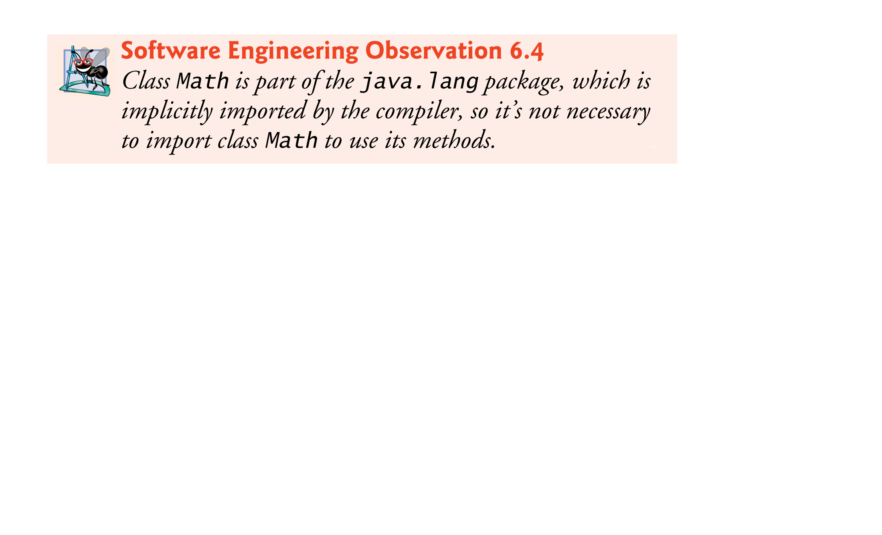
© Copyright 1992-2012 by Pearson Education, Inc. All Rights Reserved.

Slide 9
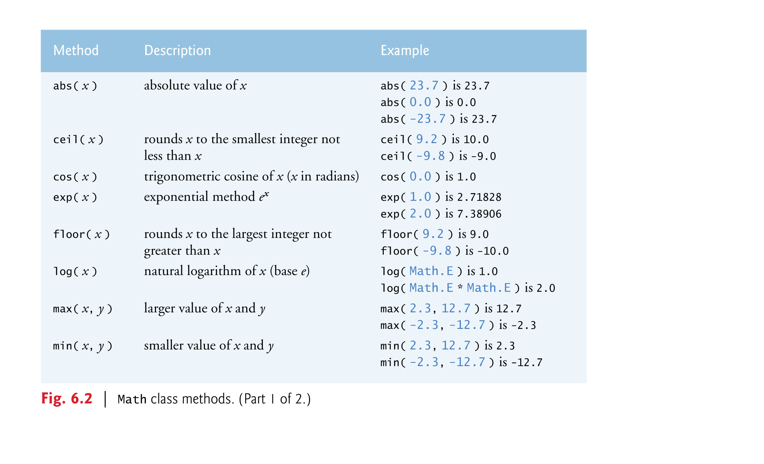
© Copyright 1992-2012 by Pearson Education, Inc. All Rights Reserved.

Slide 10
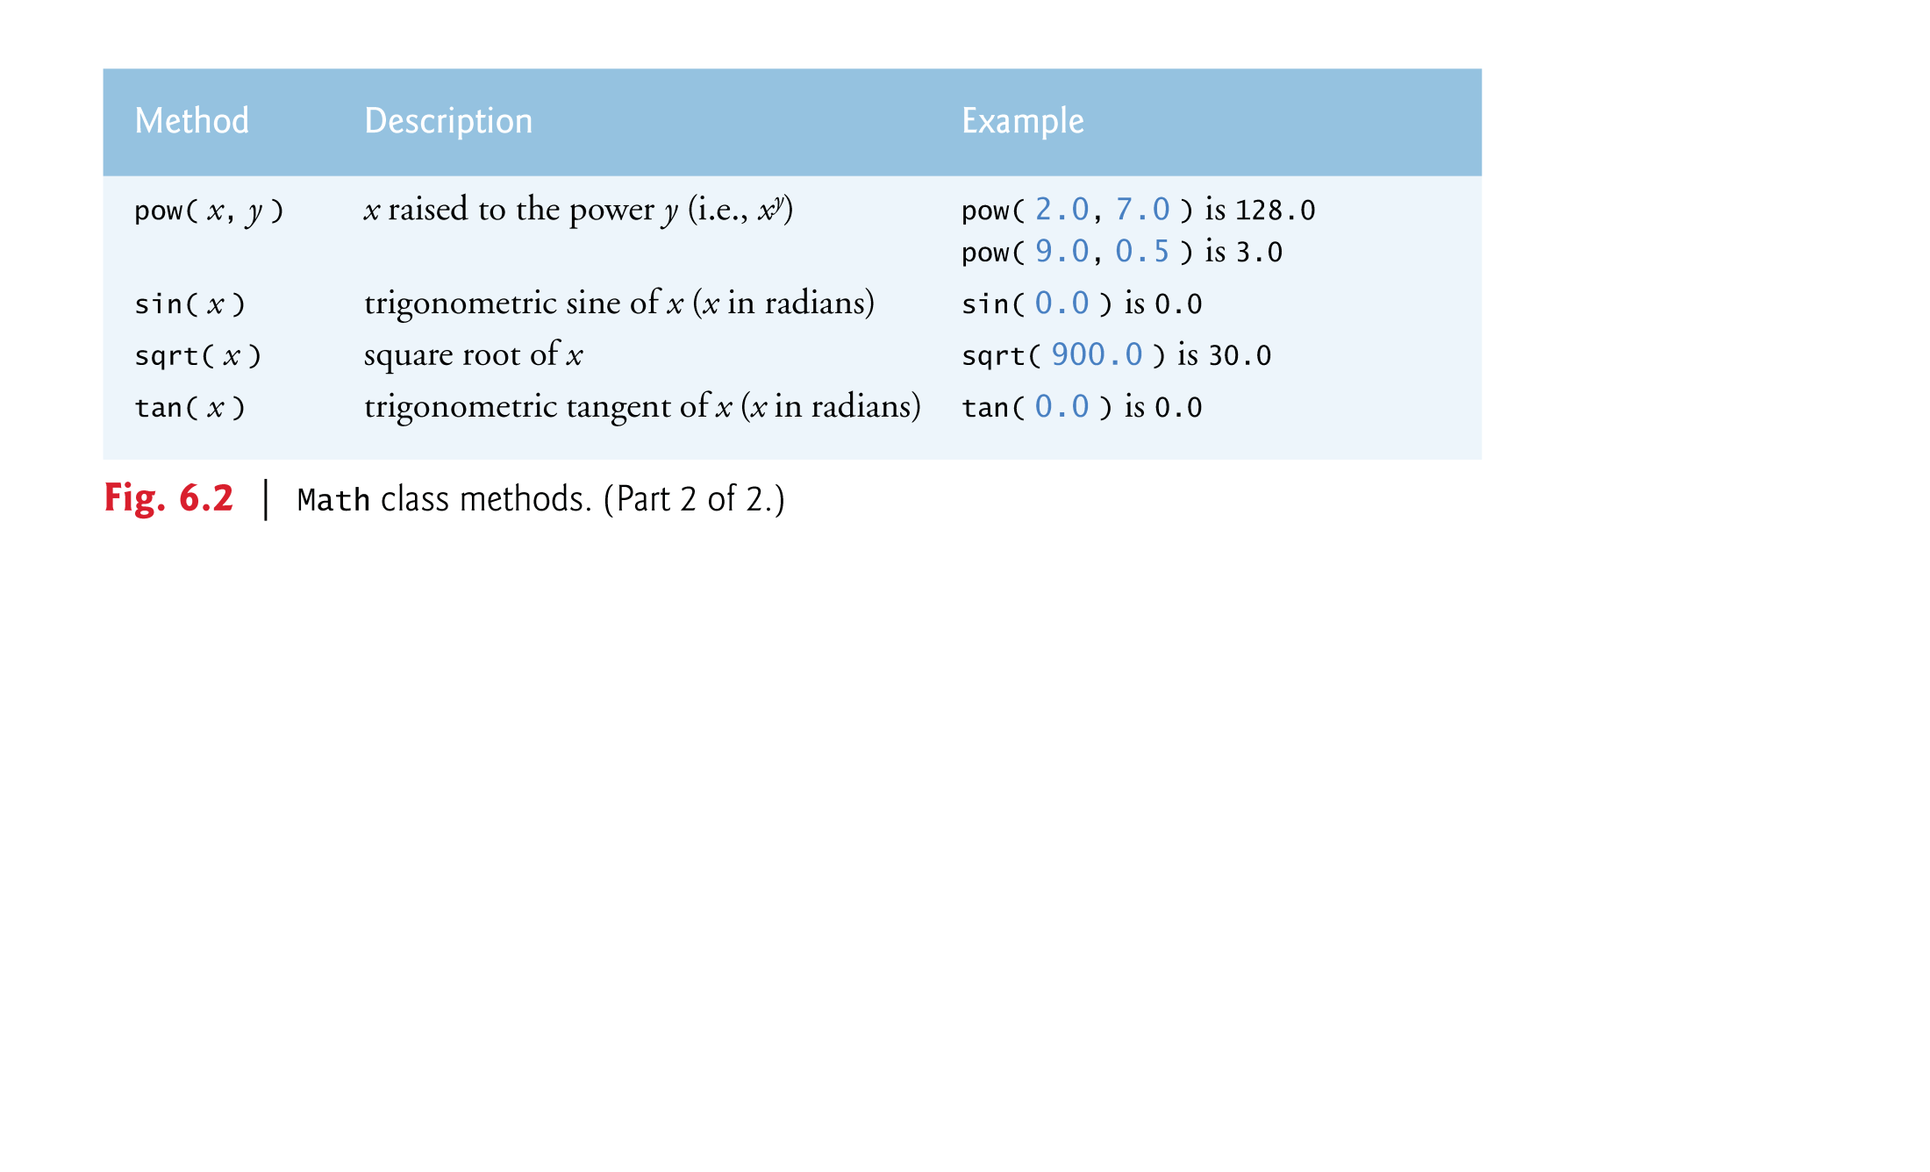
© Copyright 1992-2012 by Pearson Education, Inc. All Rights Reserved.

Slide 11
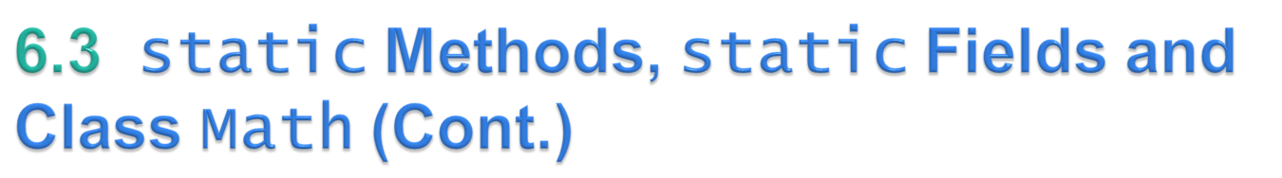
Math fields for common mathematical constants
  Math.PI (3.141592653589793)
  Math.E (2.718281828459045)
Declared in class Math with the modifiers public, final and static
  public allows you to use these fields in your own classes.
  A field declared with keyword final is constant—its value cannot change after the field is initialized.
    A constant variable should be initialized as soon as it is declared
  PI and E are declared final because their values never change.
© Copyright 1992-2012 by Pearson Education, Inc. All Rights Reserved.

Slide 12
A field that represents an attribute is also known as an instance variable—each object (instance) of the class has a separate instance of the variable in memory.
Another type of Fields: class variables.
  Single copy of class variables exist for all the class objects.
  Each object of a class does not have a separate instance of class variables
    Class variables are declared static
All objects of a class containing static fields share one copy of those fields.
Together the class variables (i.e., static variables) and instance variables represent the fields of a class.
© Copyright 1992-2012 by Pearson Education, Inc. All Rights Reserved.

Slide 13
Why is method main declared static?
  The JVM attempts to invoke the main method of the class you specify—when no objects of the class have been created.
  Declaring main as static allows the JVM to invoke main without creating an instance of the class.
© Copyright 1992-2012 by Pearson Education, Inc. All Rights Reserved.

Slide 14

String concatenation
  Assemble String objects into larger strings with operators + or +=.
When both operands of operator + are Strings, operator + creates a new String object
  characters of the right operand are placed at the end of those in the left operand
Every primitive value and object in Java has a String representation.
All objects have a toString method that returns a String representation of the object.
When one of the + operator’s operands is a String, the other is converted to a String, then the two are concatenated.
If a boolean is concatenated with a String, the boolean is converted to the String "true" or "false".
© Copyright 1992-2012 by Pearson Education, Inc. All Rights Reserved.

Slide 15
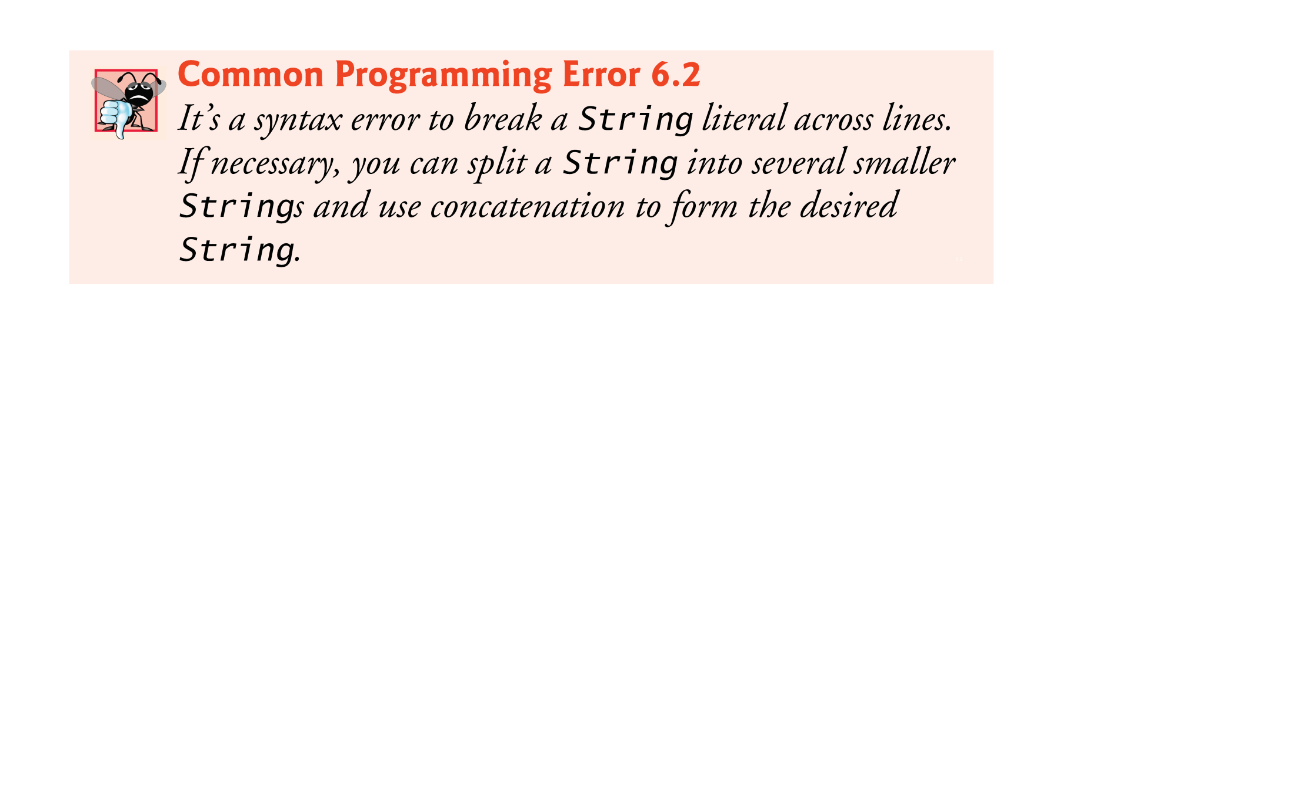
© Copyright 1992-2012 by Pearson Education, Inc. All Rights Reserved.

Slide 16
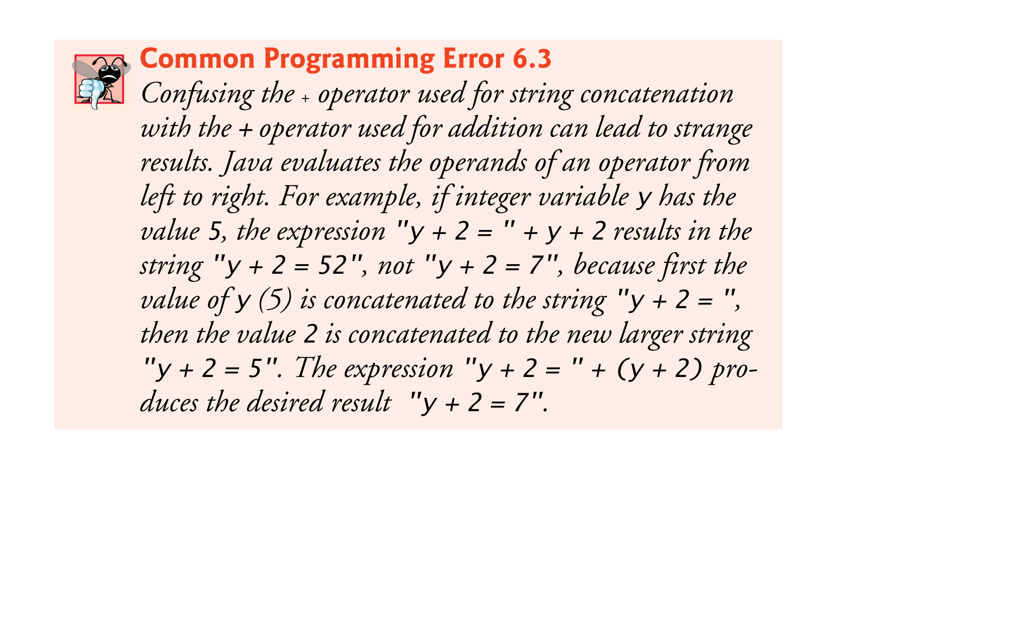
© Copyright 1992-2012 by Pearson Education, Inc. All Rights Reserved.

Slide 17

Three ways to call a method:
  Using a method name by itself to call another method of the same class
  Using a variable that contains a reference to an object, followed by a dot (.) and the method name to call a method of the referenced object
  Using the class name and a dot (.) to call a static method of a class
© Copyright 1992-2012 by Pearson Education, Inc. All Rights Reserved.

Slide 18

A non-static method can call any method of the same class directly and can manipulate any of the class’s fields directly.
A static method can call only other static methods of the same class directly and can manipulate only static fields in the same class directly.
© Copyright 1992-2012 by Pearson Education, Inc. All Rights Reserved.

Slide 19
Three ways to return control to the statement that calls a method:
  When the program flow reaches the method-ending right brace
  When the following statement executes
    return;
  When the method returns a result with a statement like
    return expression;
© Copyright 1992-2012 by Pearson Education, Inc. All Rights Reserved.

Slide 20
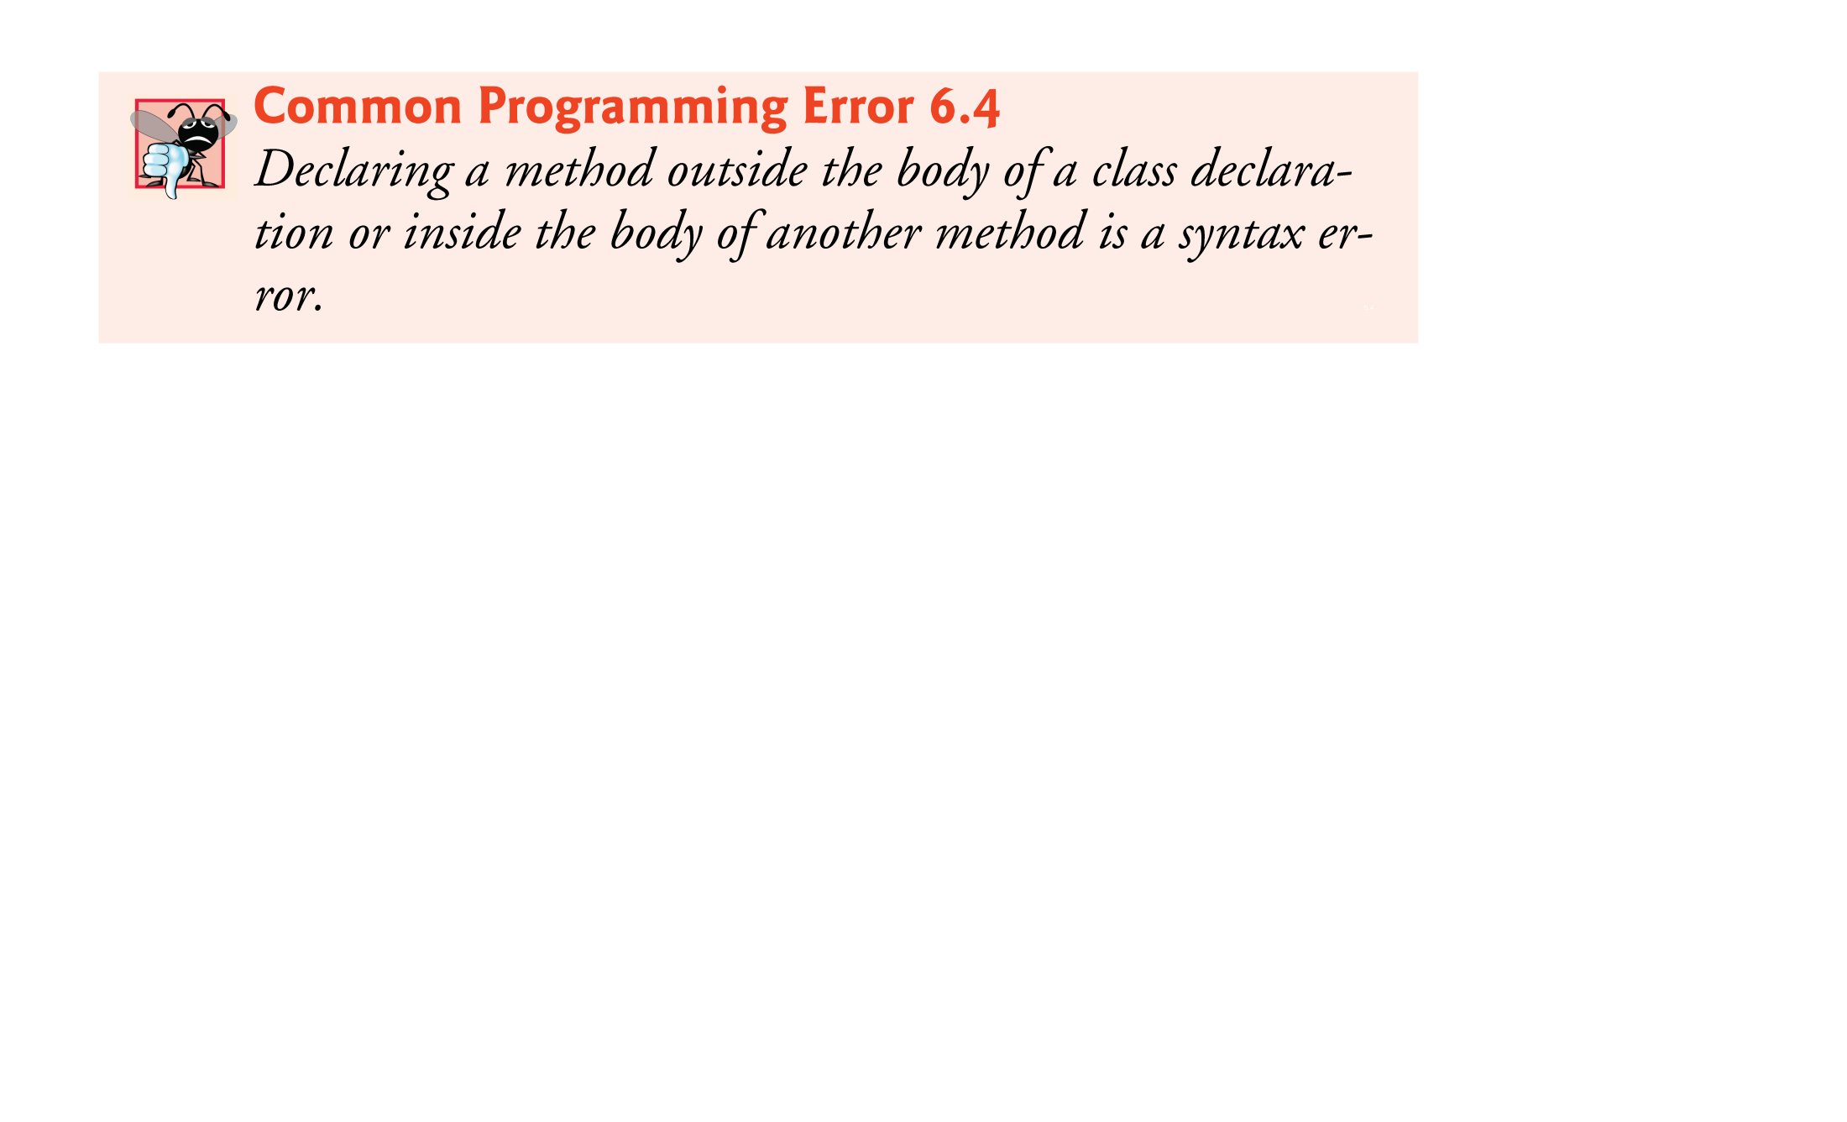
© Copyright 1992-2012 by Pearson Education, Inc. All Rights Reserved.

Slide 21


Slide 22
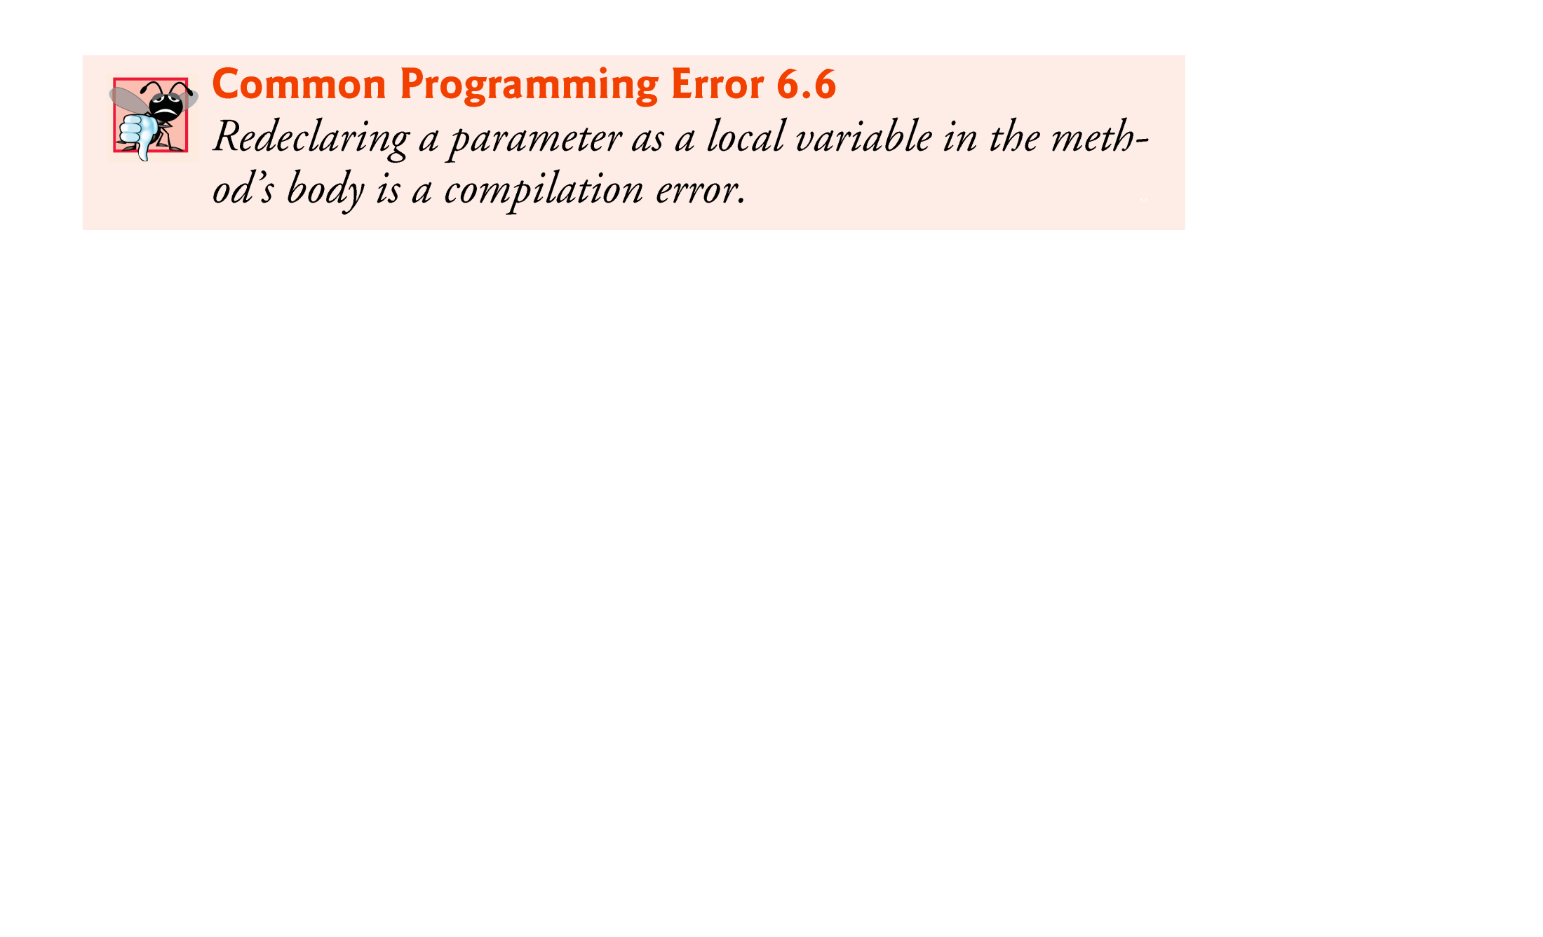

Slide 23
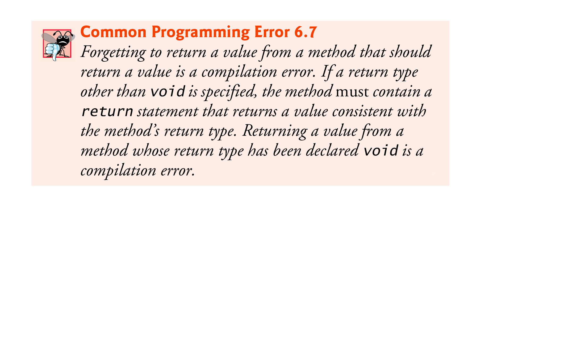

Slide 24

Argument promotion
  Converting an argument’s value, if possible, to the type that the method expects to receive in its corresponding parameter.
At attempt of conversions may lead to compilation errors if Java’s promotion rules are not satisfied.
Promotion rules
  specify which conversions are allowed.
  apply to expressions containing values of two or more primitive types (e.g. float x = 3; or int c = ‘a’;) and to primitive-type values passed as arguments to methods (e.g. if parameter type is integer, but an ‘a’ is passed as argument).
Each value is promoted to the “highest” type in the expression.
Figure 6.4 lists the primitive types and the types to which each can be promoted.
© Copyright 1992-2012 by Pearson Education, Inc. All Rights Reserved.

Slide 25
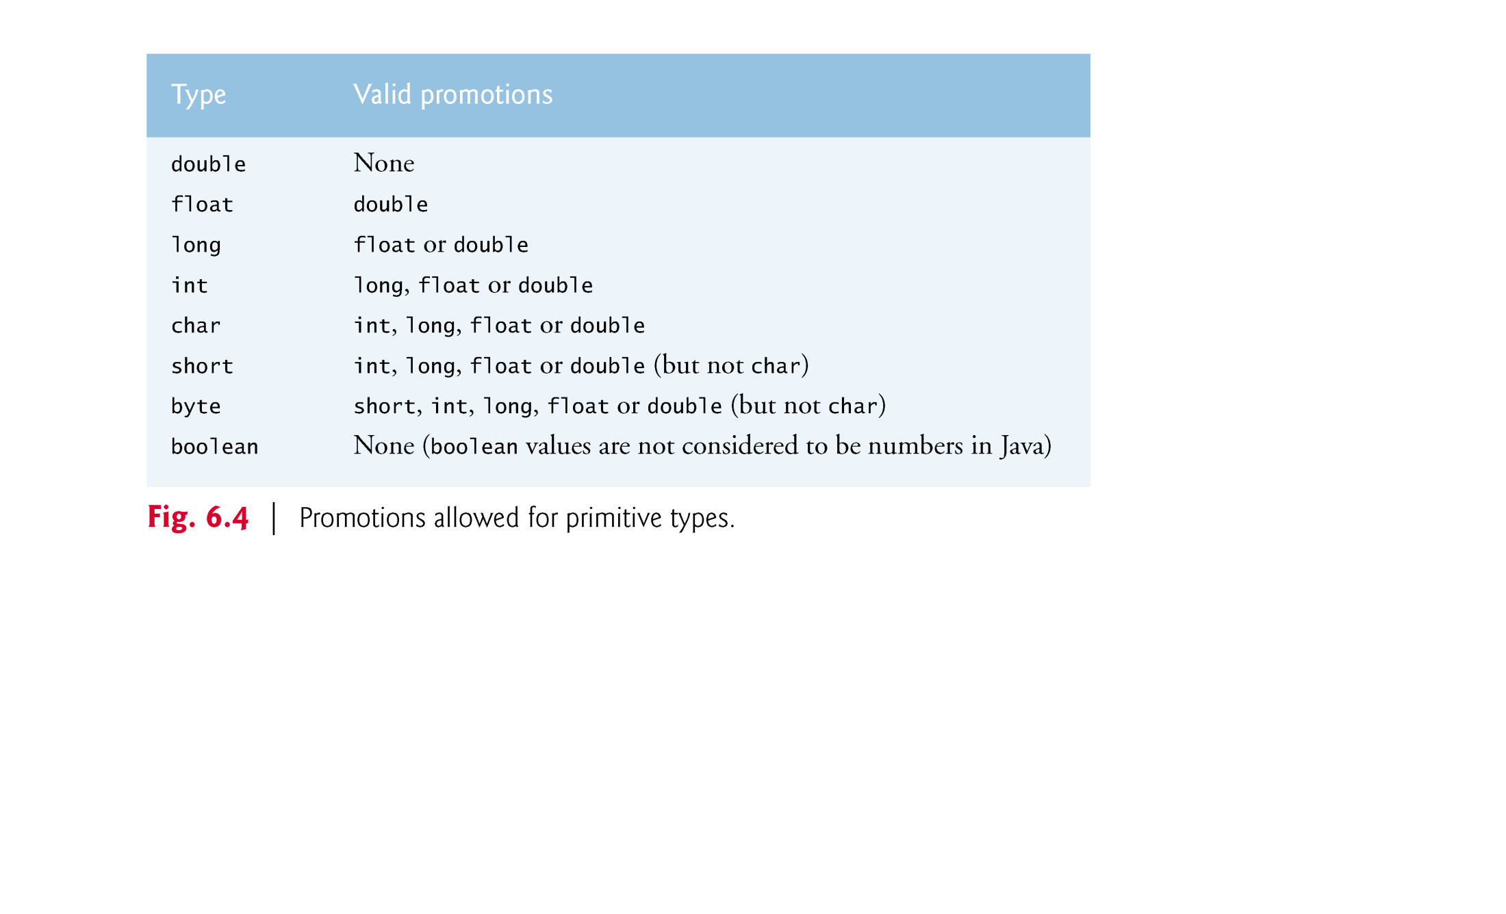

Slide 26
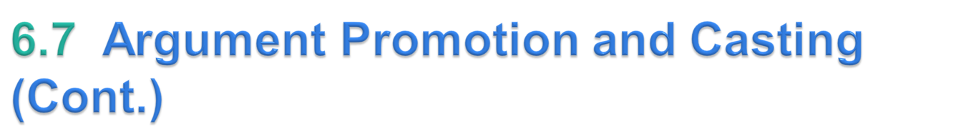
Converting values to types lower in the table of Fig. 6.4 will result in different values if the lower type cannot represent the value of the higher type
In cases where information may be lost due to conversion, the Java compiler requires you to use a cast operator to explicitly force the conversion to occur—otherwise a compilation error occurs.
© Copyright 1992-2012 by Pearson Education, Inc. All Rights Reserved.

Slide 27
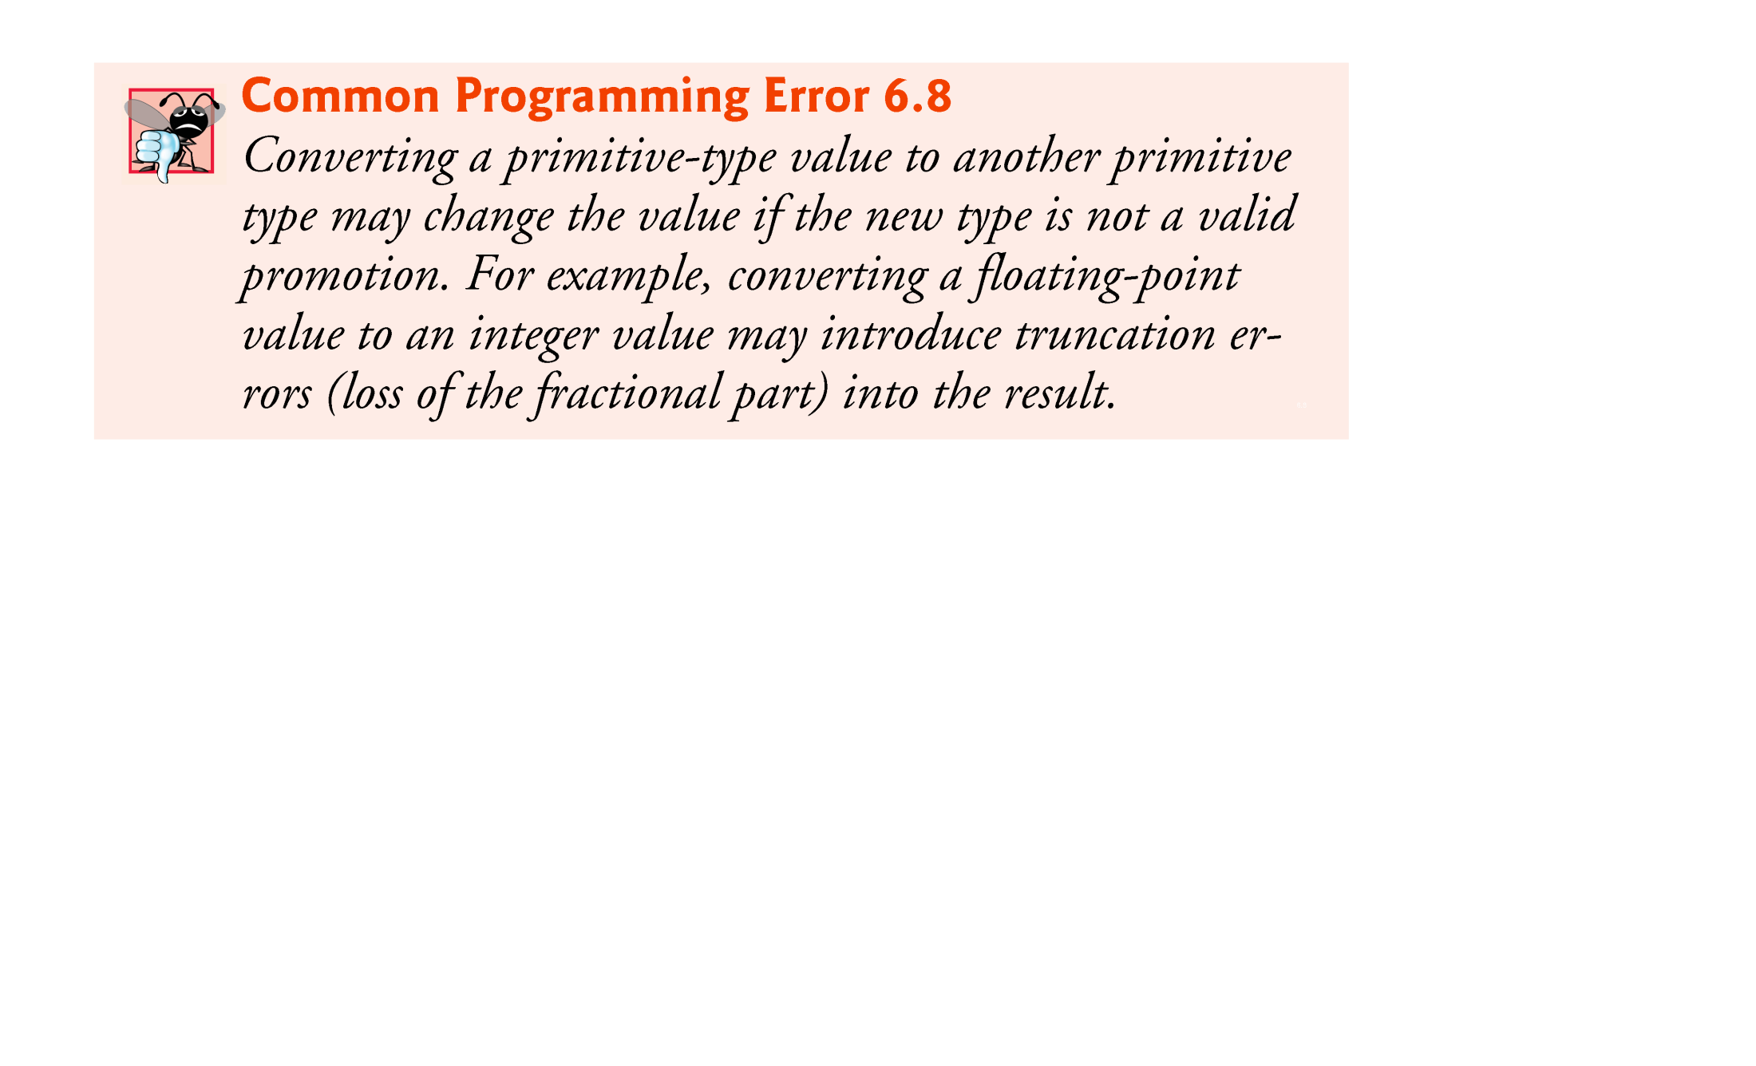

Slide 28

Read Topic 6.9: case study of Random number generation (Pg. 215-220)
Read Topic 6.10: case study of A game of chance (Pg. 220-225)
© Copyright 1992-2012 by Pearson Education, Inc. All Rights Reserved.

Slide 29

Declarations introduce names that can be used to refer to such Java entities (e.g. variables, methods).
The scope of a declaration is the portion of the program that can refer to the declared entity by its name.
  Such an entity is said to be “in scope” for that portion of the program.
© Copyright 1992-2012 by Pearson Education, Inc. All Rights Reserved.

Slide 30

Basic scope rules:
  The scope of a parameter declaration is the body of the method in which the declaration appears.
  The scope of a local-variable declaration is from the point at which the declaration appears to the end of that block.
  The scope of a local-variable declaration that appears in the initialization section of a for statement’s header is the body of the for statement and the other expressions in the header.
  A method or field’s scope is the entire body of the class. Outside the class, you may need to create an object of class.
Any block may contain variable declarations.
If a local variable or parameter in a method has the same name as a field of the class, the field is “hidden” until the block terminates execution—this is called shadowing.
© Copyright 1992-2012 by Pearson Education, Inc. All Rights Reserved.

Slide 31
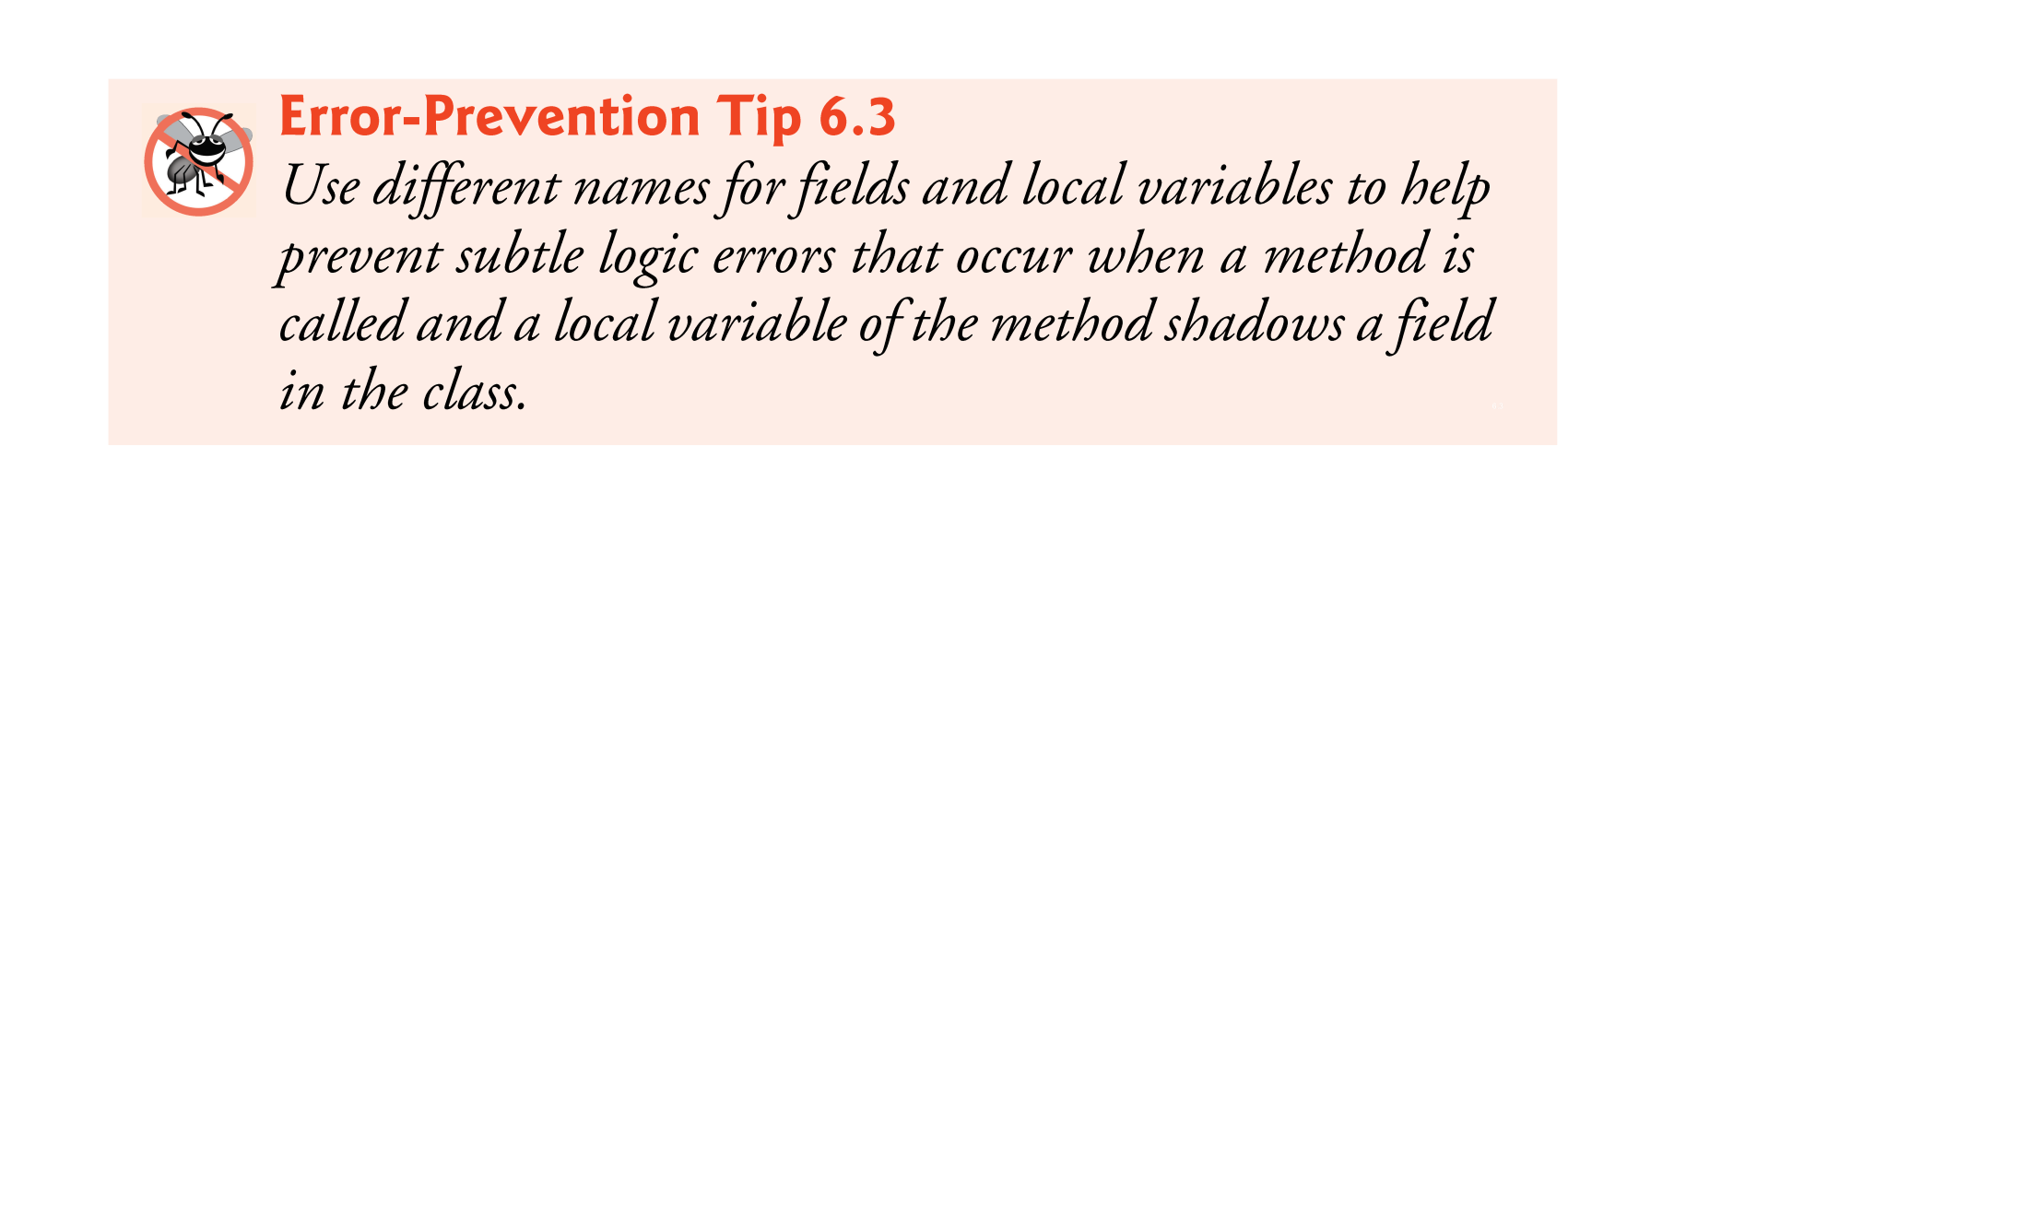
© Copyright 1992-2012 by Pearson Education, Inc. All Rights Reserved.

Slide 32
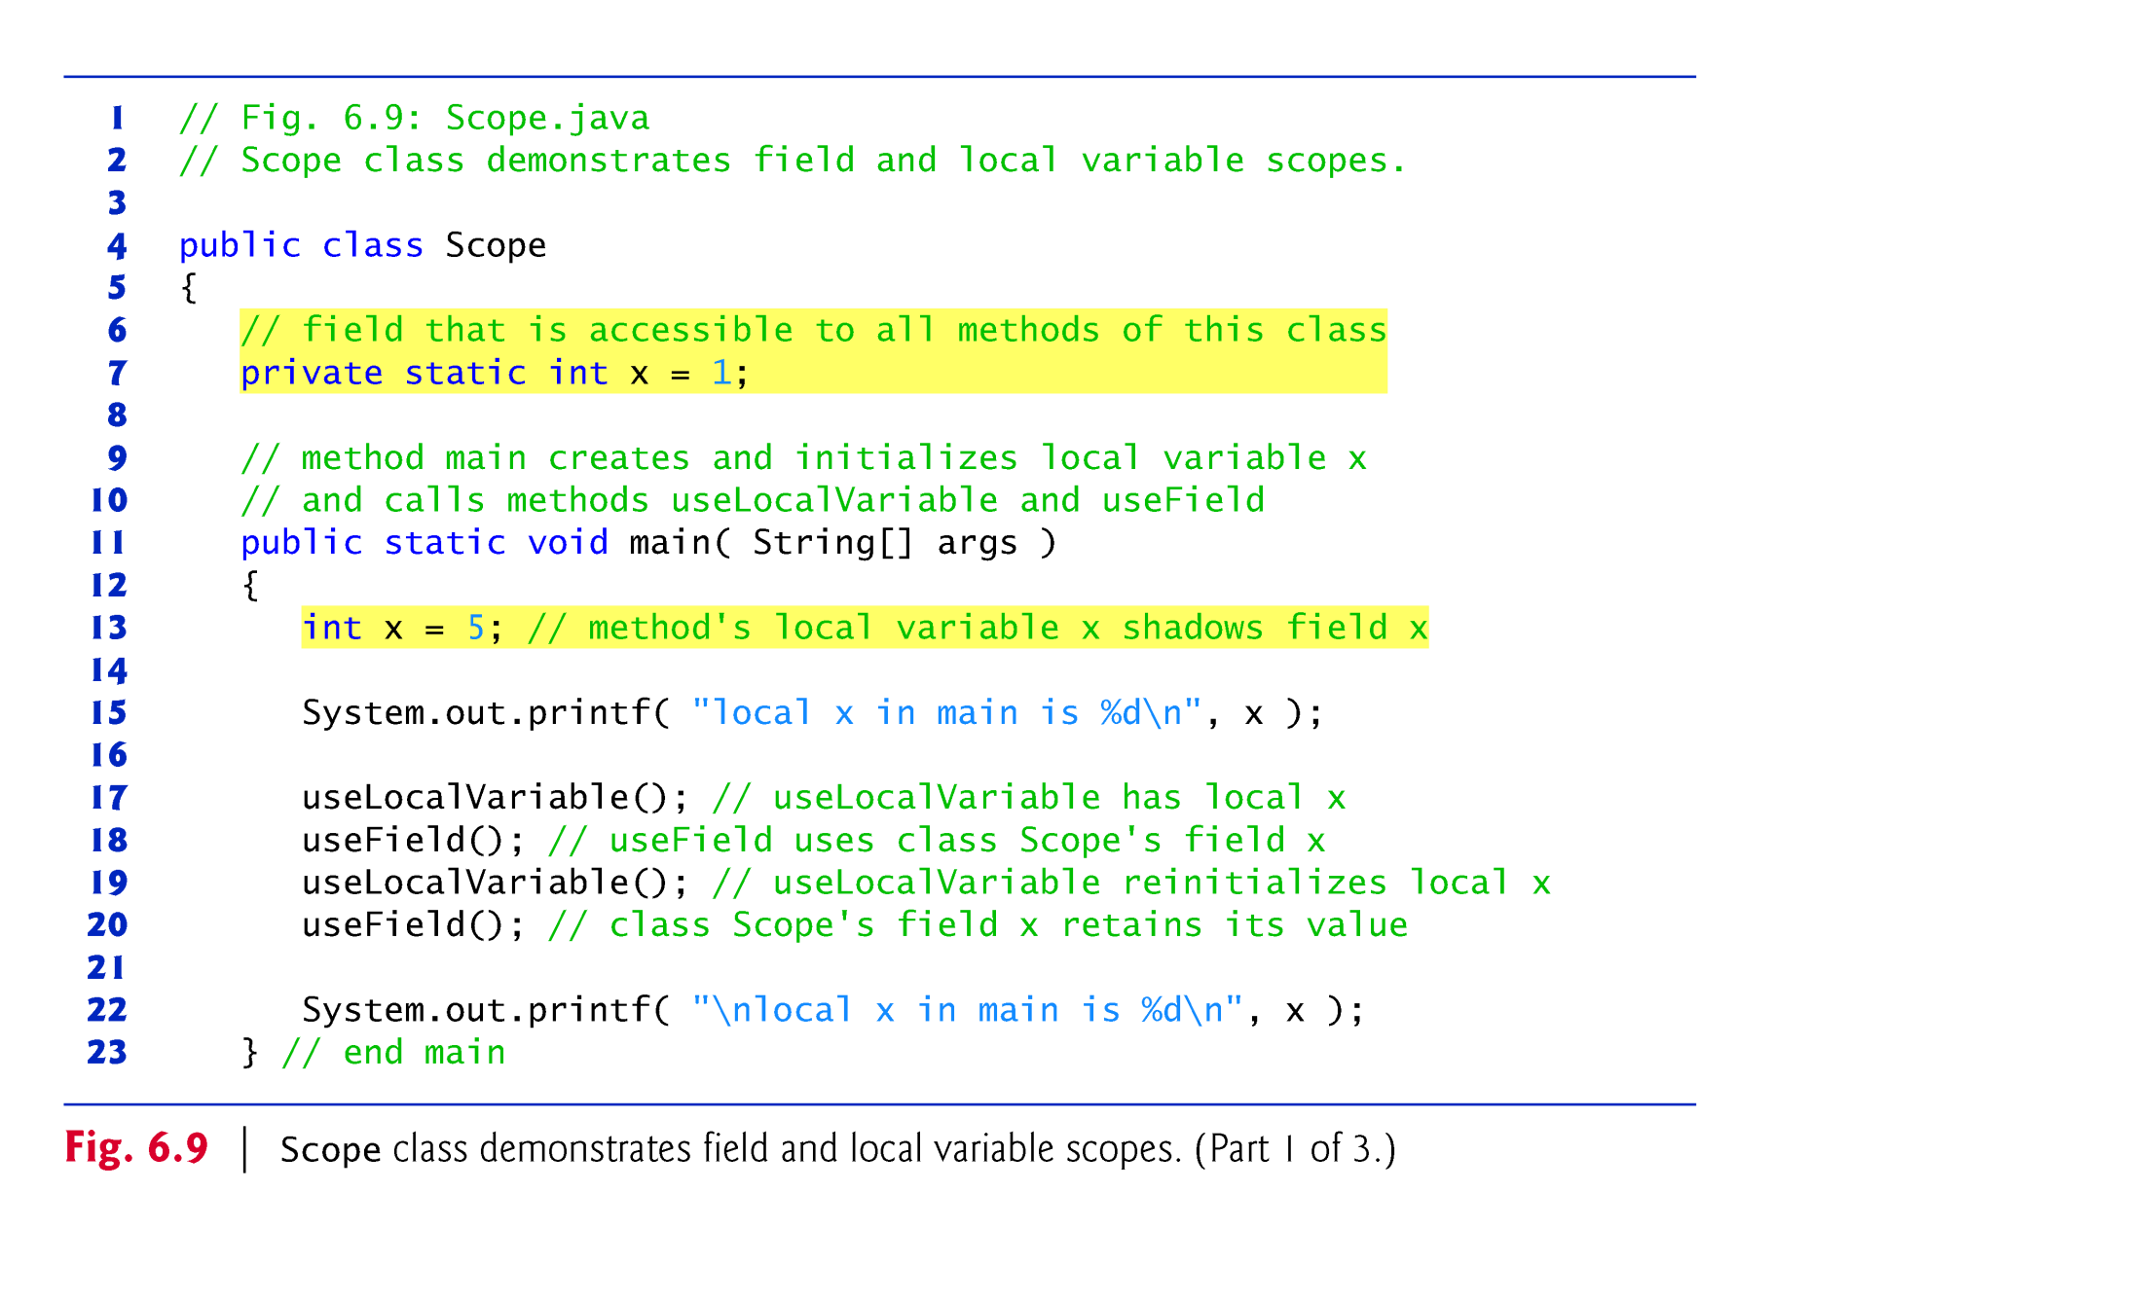

Slide 33
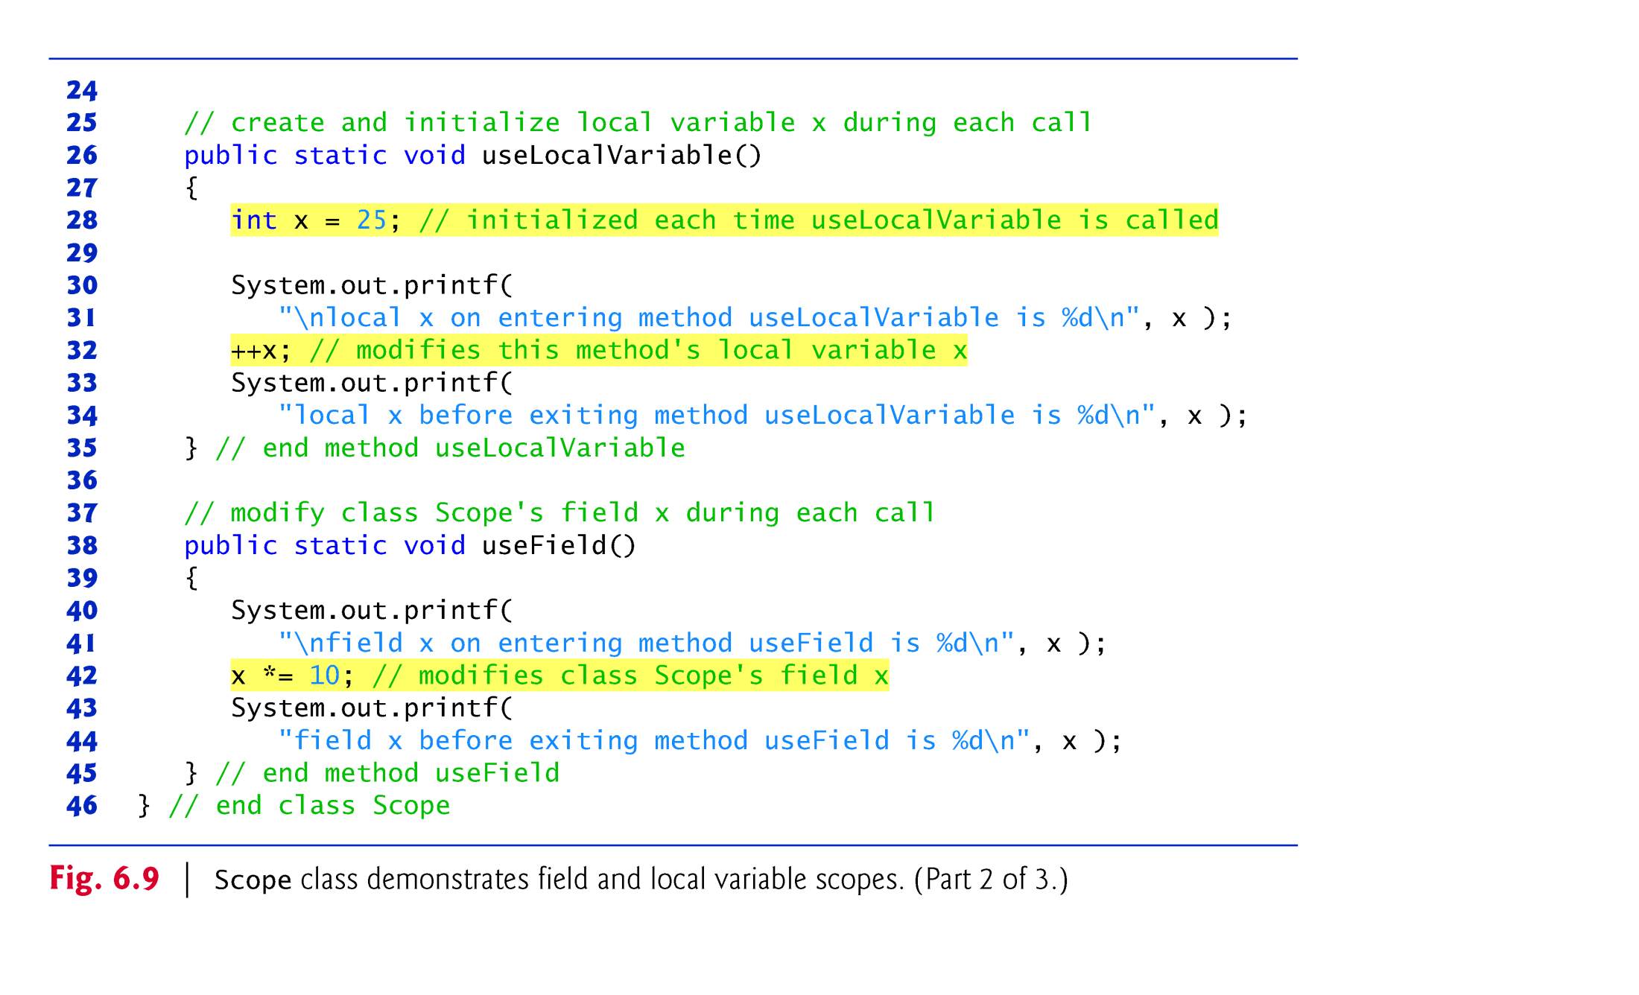

Slide 34
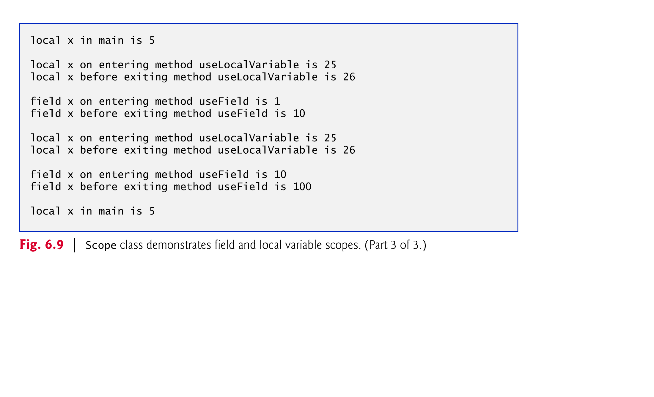

Slide 35

It is possible to have multiple methods having the same name
Method overloading
  Methods of the same name declared in the same class
  Must have different sets of parameters
Compiler selects the appropriate method to call by examining the number, types and order of the arguments in the call.
Used to create several methods with the same name that perform the same or similar tasks, but on different types or different numbers of arguments.
Example
  Literal integer values are treated as type int, so the method call in line 9 invokes the version of square that specifies an int parameter.
  Literal floating-point values are treated as type double, so the method call in line 10 invokes the version of square that specifies a double parameter.
© Copyright 1992-2012 by Pearson Education, Inc. All Rights Reserved.

Slide 36
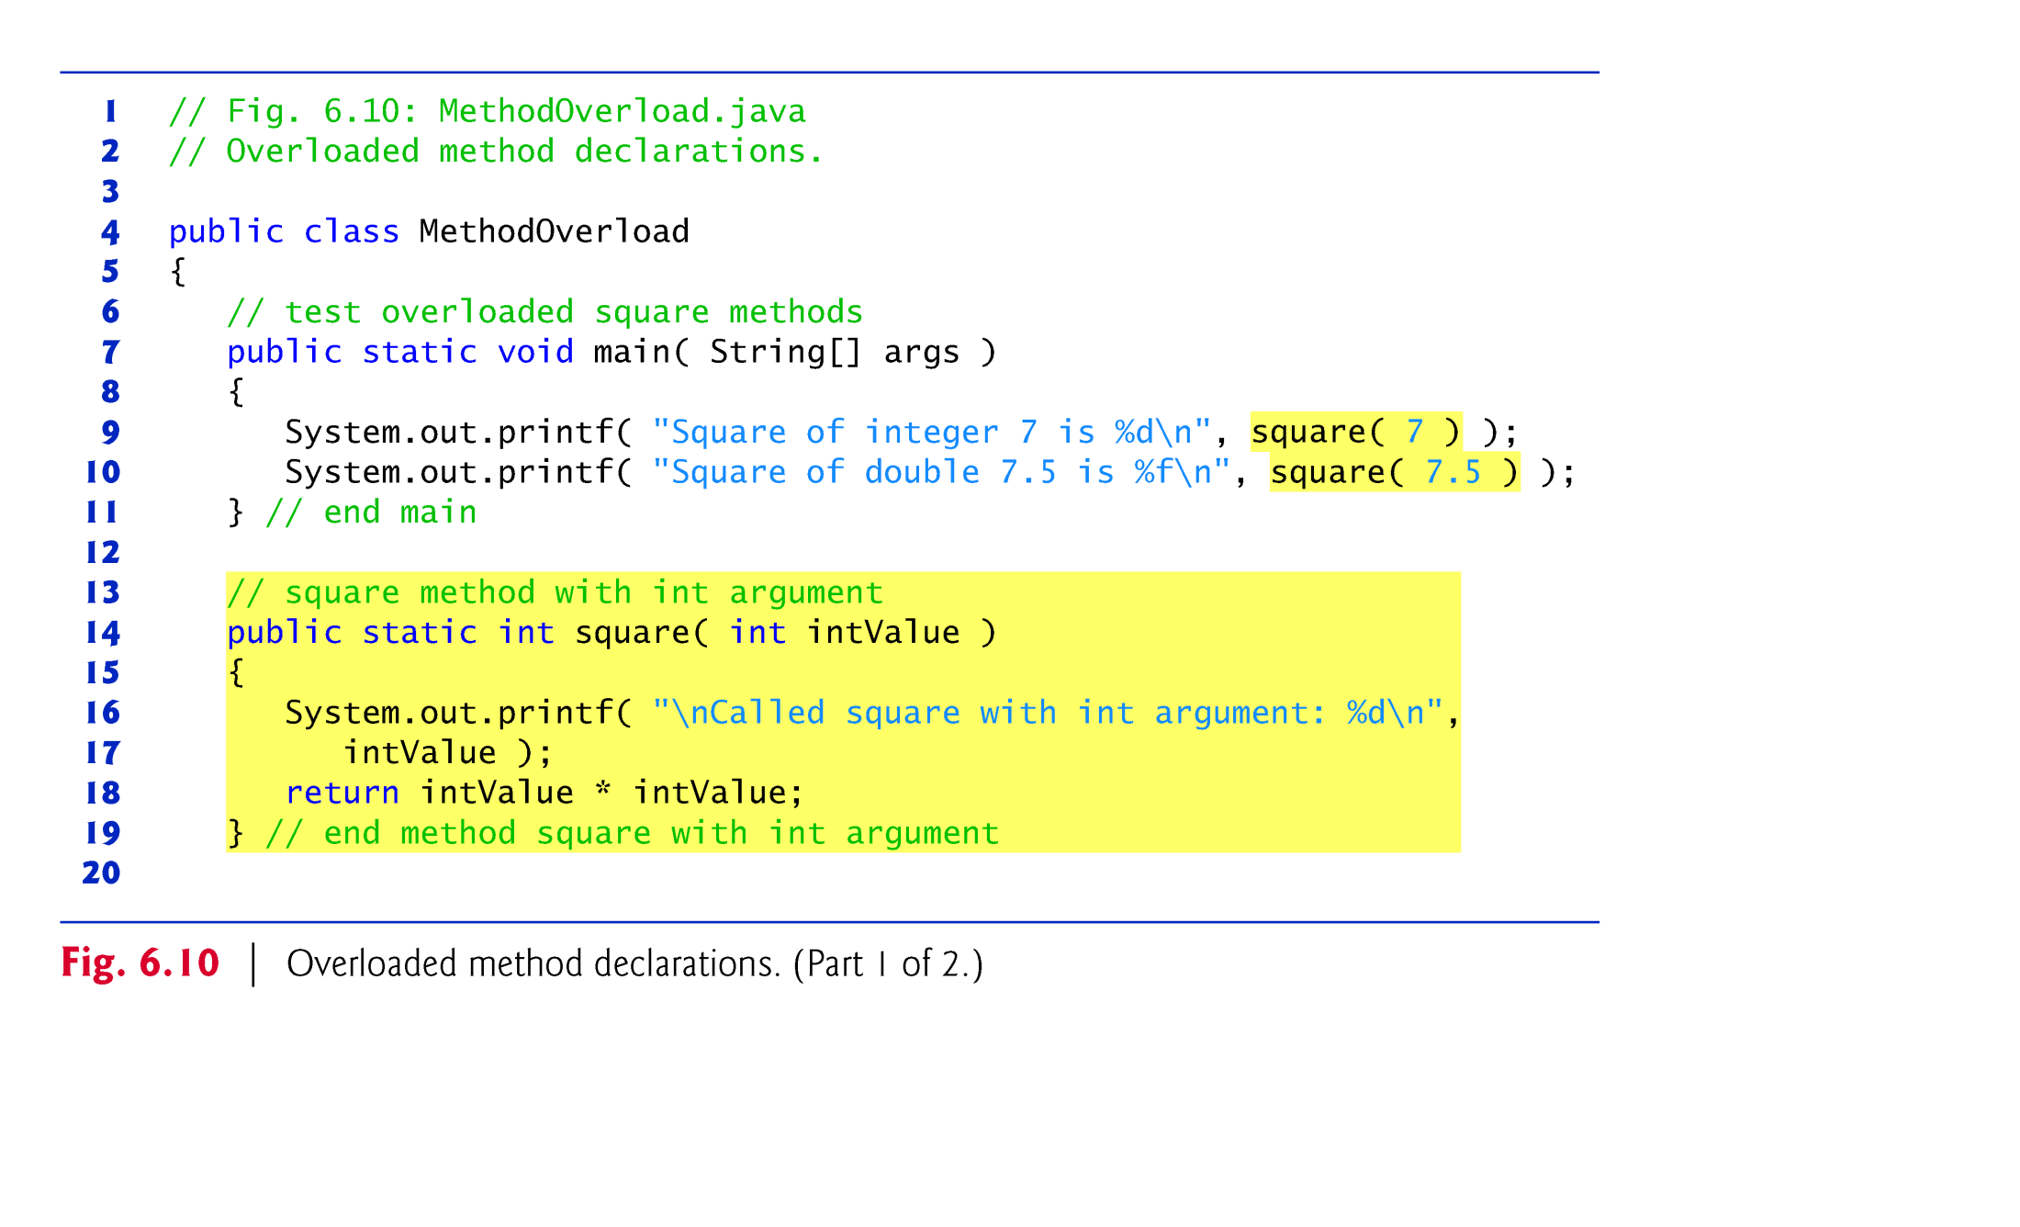

Slide 37
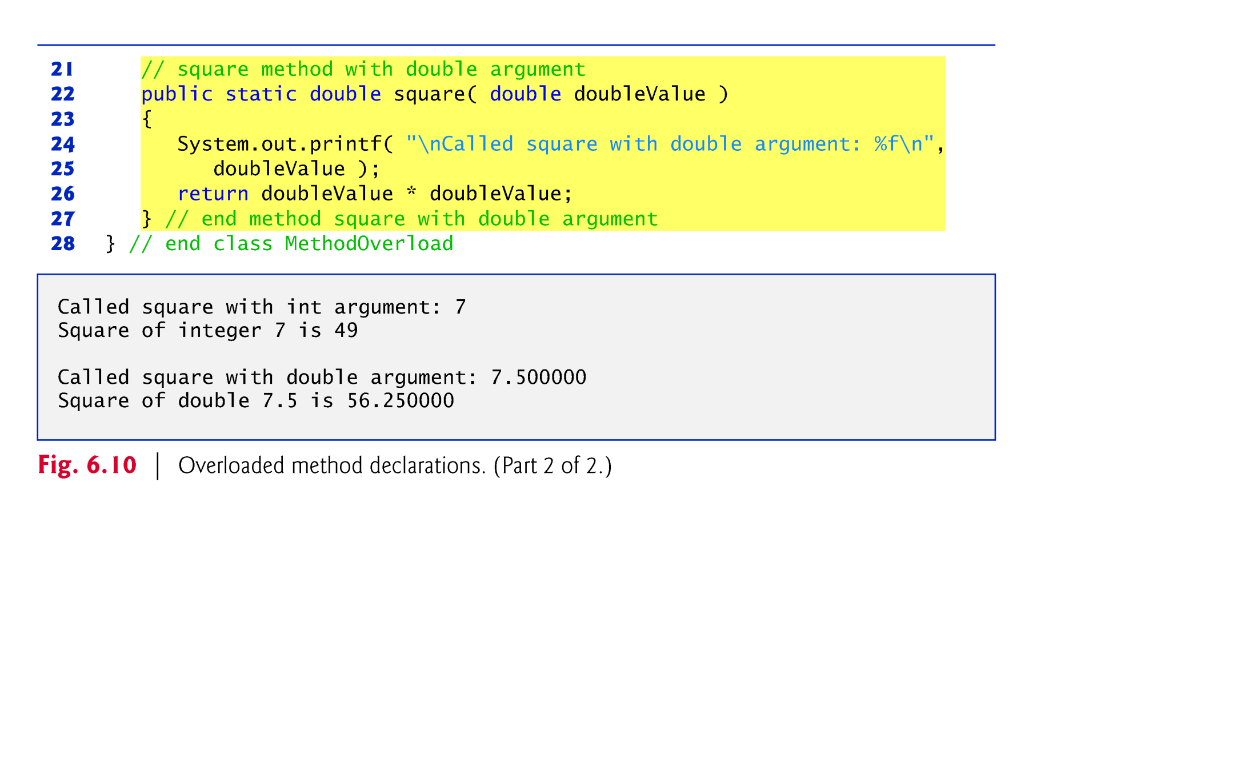

Slide 38

Distinguishing Between Overloaded Methods
  The compiler distinguishes overloaded methods by their signatures—the methods’ names and the number, types and order of their parameters.
Return types of overloaded methods
  Method calls cannot be distinguished by return type.
Overloaded methods can have different return types if the methods have different parameter lists.
Overloaded methods need not have the same number of parameters.
© Copyright 1992-2012 by Pearson Education, Inc. All Rights Reserved.

Slide 39


Slide 40

Java contains many predefined classes that are grouped into categories of related classes called packages.
A great strength of Java is the Java API’s thousands of classes.
Some key Java API packages are described in Fig. 6.5.
Overview of the packages in Java SE 6:
    download.oracle.com/javase/6/docs/api/
    overview-summary.html
Java API documentation
    download.oracle.com/javase/6/docs/api/
© Copyright 1992-2012 by Pearson Education, Inc. All Rights Reserved.

Slide 41
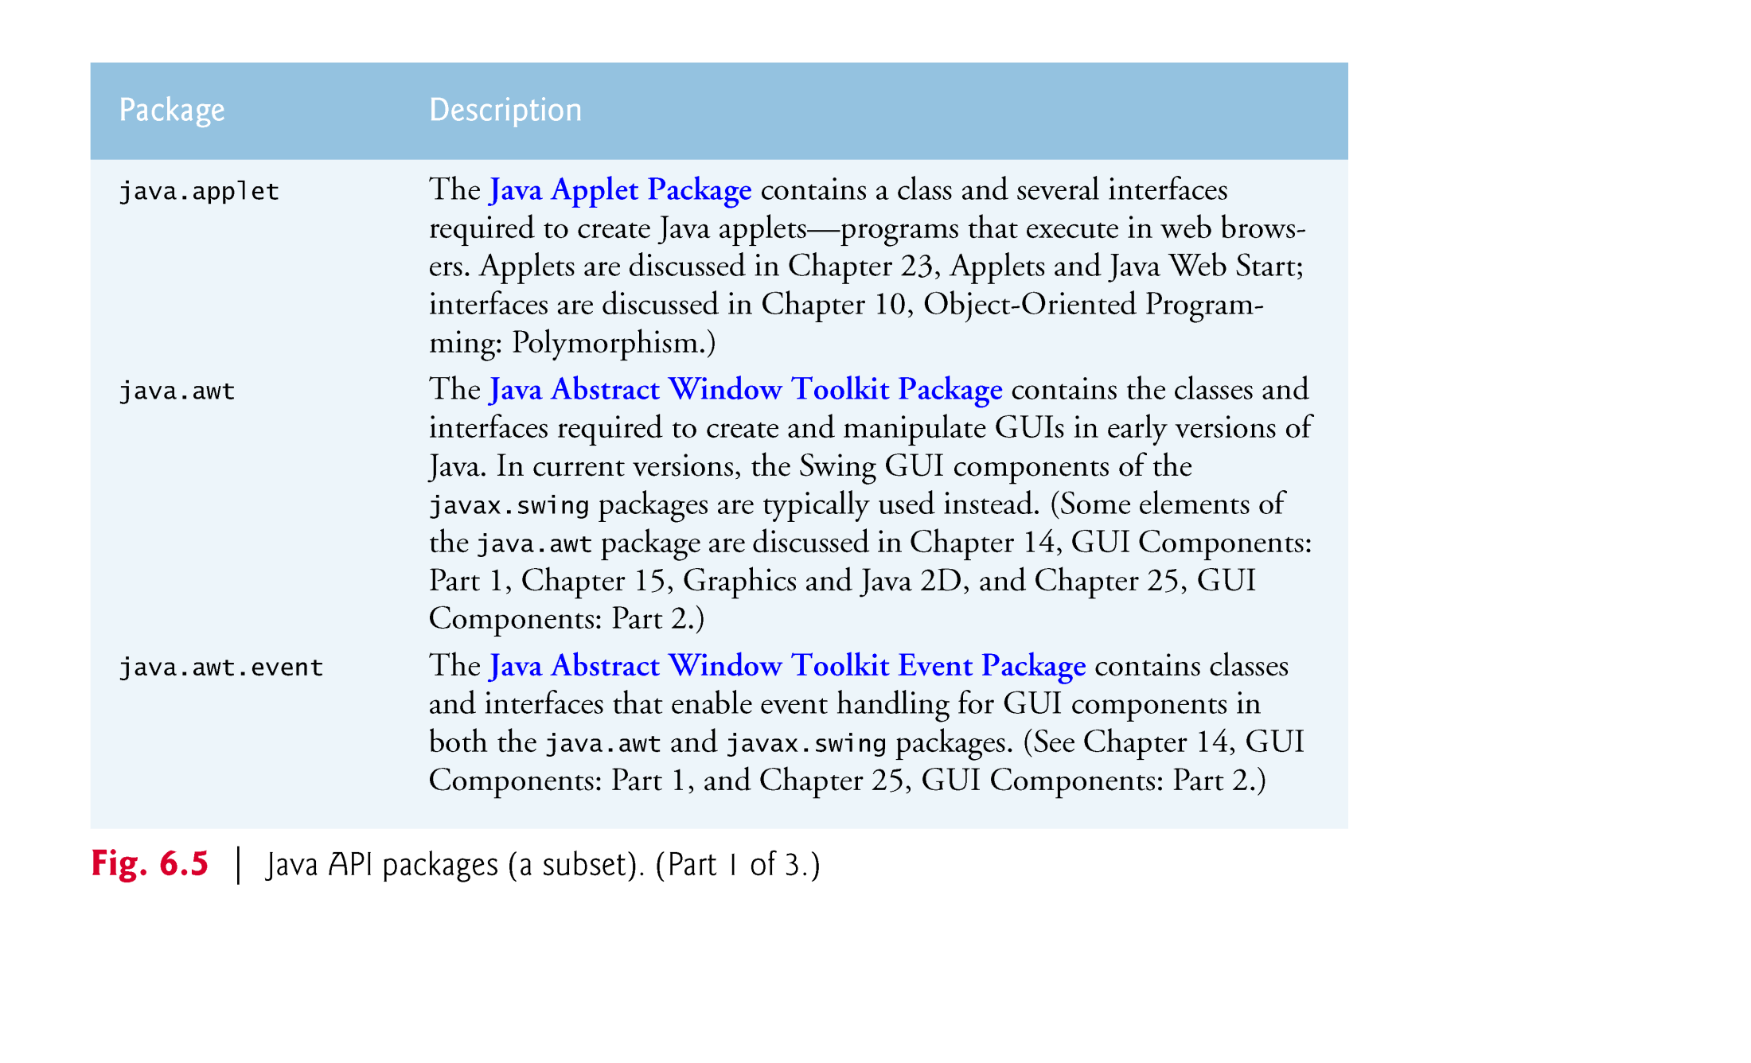

Slide 42
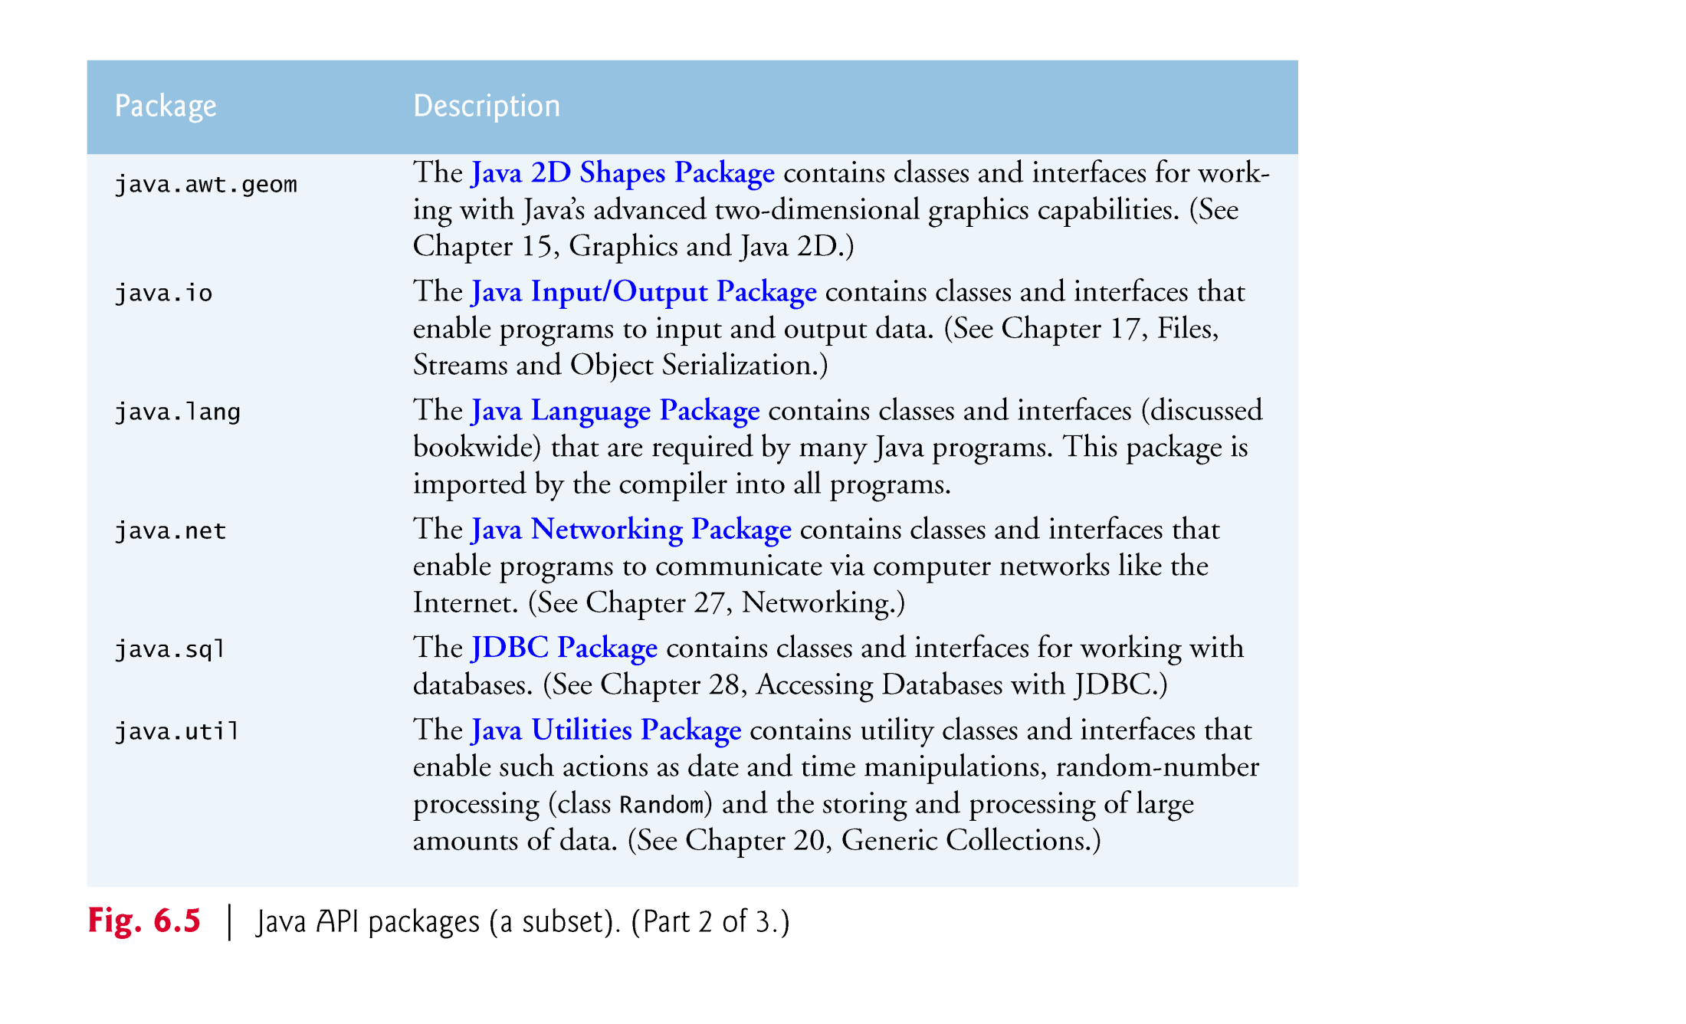

Slide 43
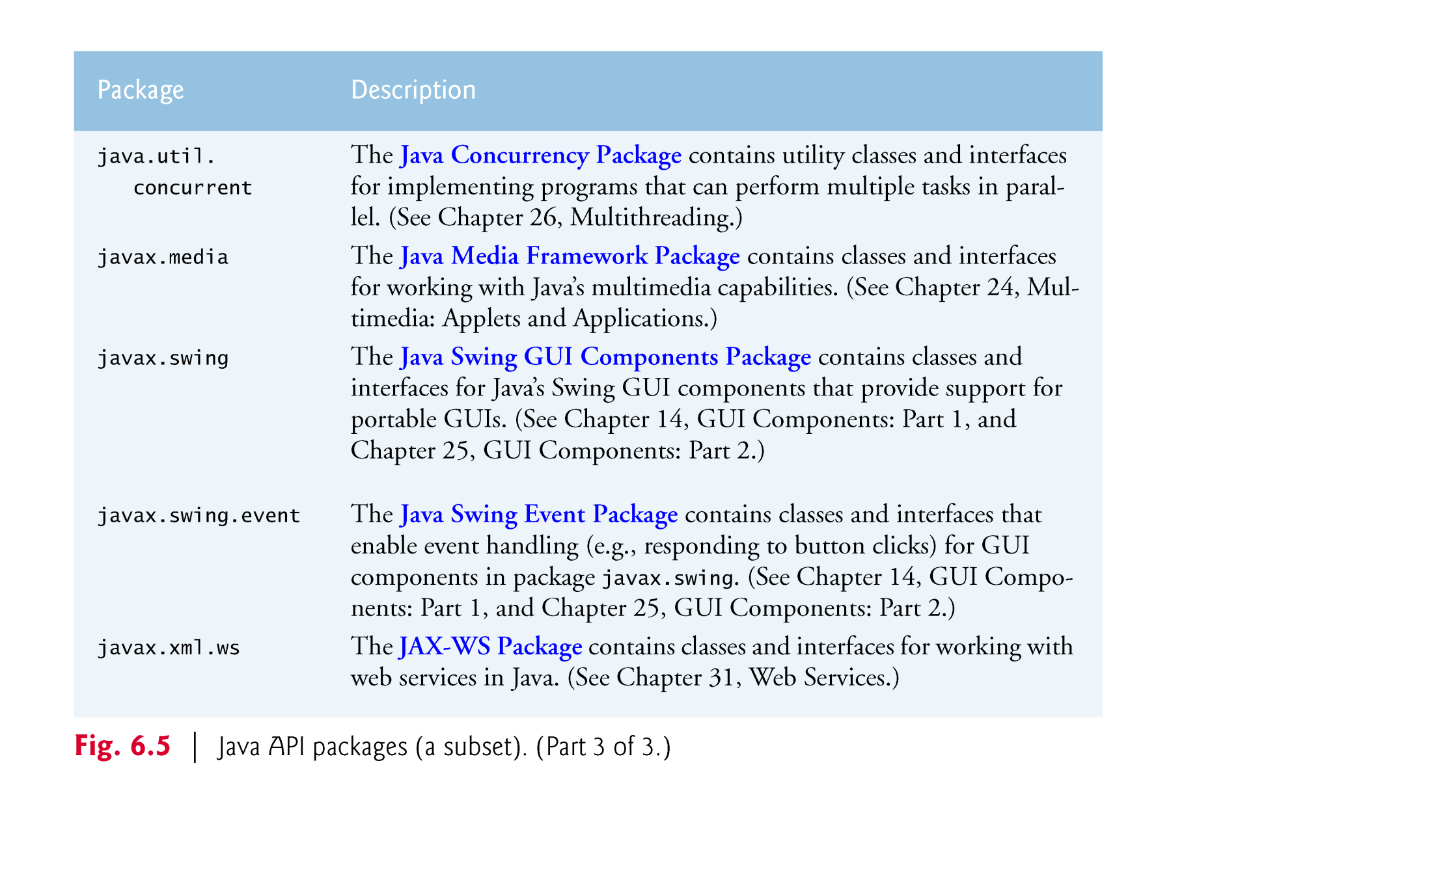

Slide 44
END of Lecture Slides
© Copyright 1992-2012 by Pearson Education, Inc. All Rights Reserved.

Slide 45

Simulation and game playing
  element of chance
  Class Random (package java.util)
  static method random of class Math.
Objects of class Random can produce random boolean, byte, float, double, int, long and Gaussian values
Math method random can produce only double values in the range 0.0 ≤ x < 1.0.
Documentation for class Random
    download.oracle.com/javase/6/docs/api/java/
    util/Random.html
© Copyright 1992-2012 by Pearson Education, Inc. All Rights Reserved.

Slide 46

Class Random produces pseudorandom numbers
  A sequence of values produced by a complex mathematical calculation.
  The calculation uses the current time of day to seed the random-number generator.
The range of values produced directly by Random method nextInt often differs from the range of values required in a particular Java application.
Random method nextInt that receives an int argument returns a value from 0 up to, but not including, the argument’s value.
© Copyright 1992-2012 by Pearson Education, Inc. All Rights Reserved.

Slide 47
Rolling a Six-Sided Die
    face = 1 + randomNumbers.nextInt( 6 );
  The argument 6—called the scaling factor—represents the number of unique values that nextInt should produce (0–5)
  This is called scaling the range of values
  A six-sided die has the numbers 1–6 on its faces, not 0–5.
  We shift the range of numbers produced by adding a shifting value—in this case 1—to our previous result, as in
  The shifting value (1) specifies the first value in the desired range of random integers.
© Copyright 1992-2012 by Pearson Education, Inc. All Rights Reserved.

Slide 48
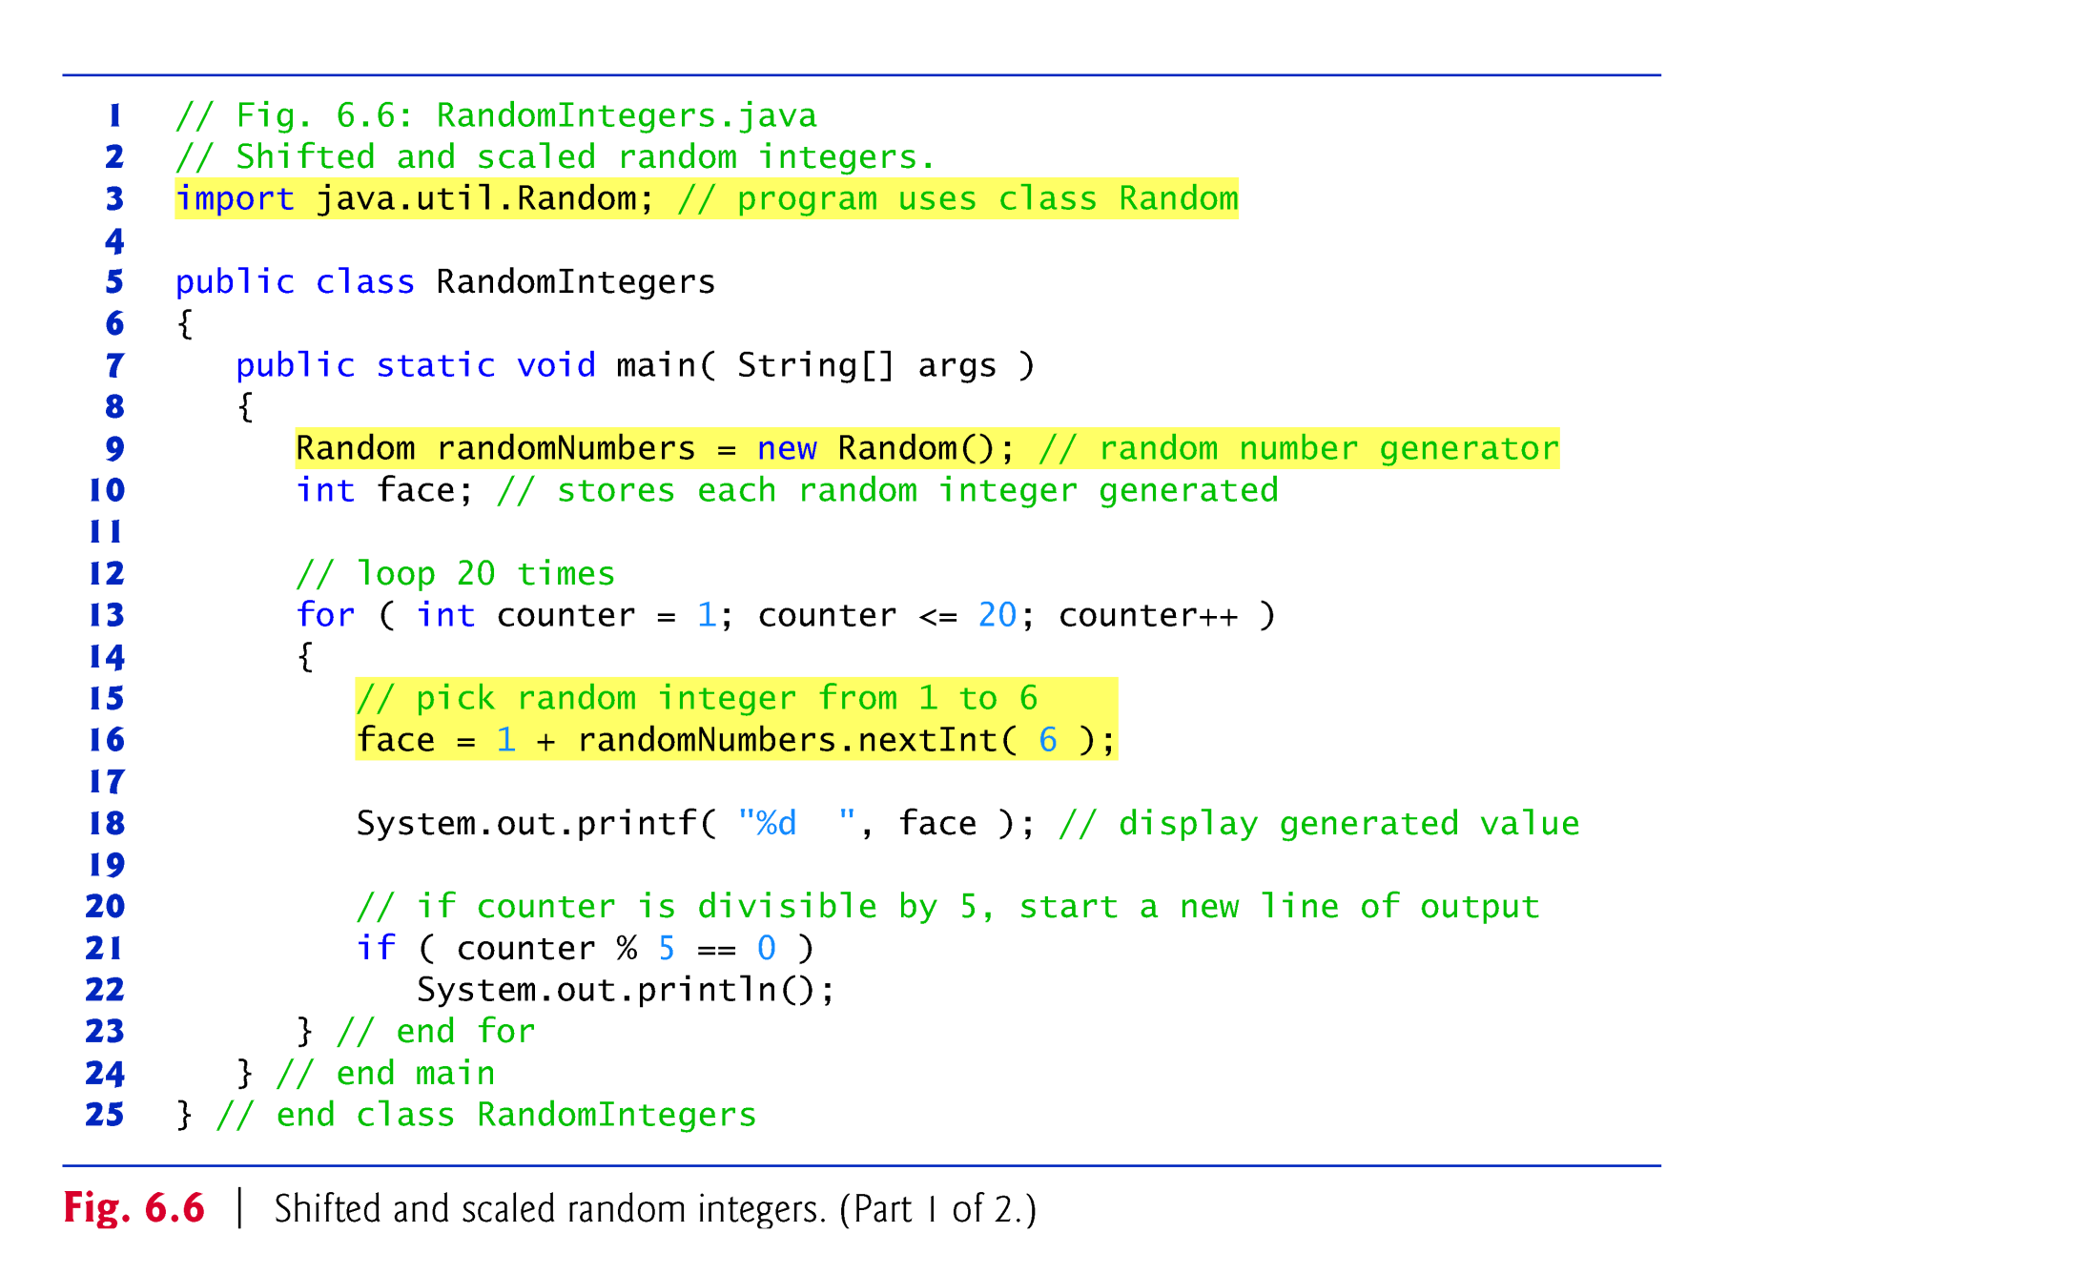

Slide 49
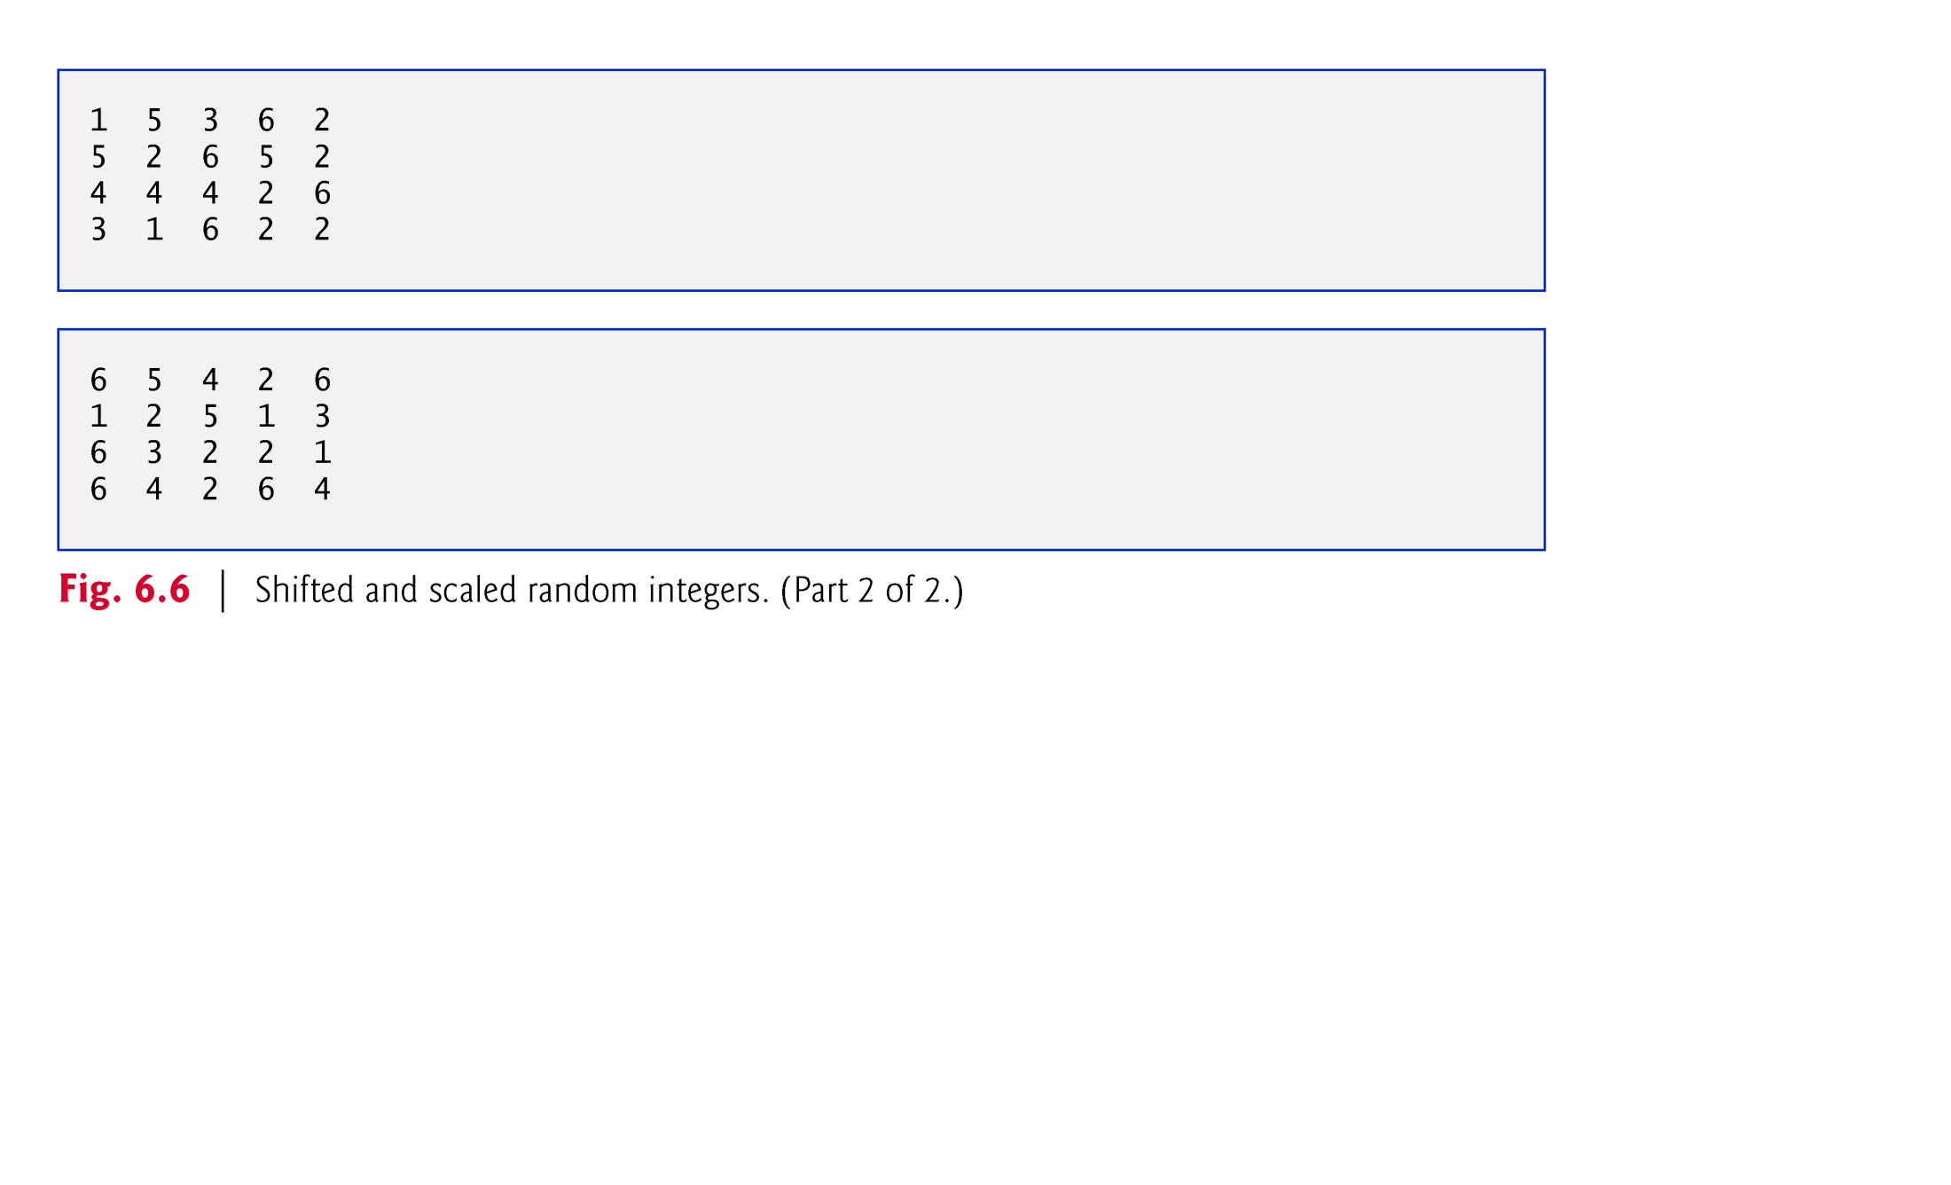

Slide 50
Fig 6.7: Rolling a Six-Sided Die 6,000,000 Times
© Copyright 1992-2012 by Pearson Education, Inc. All Rights Reserved.

Slide 51
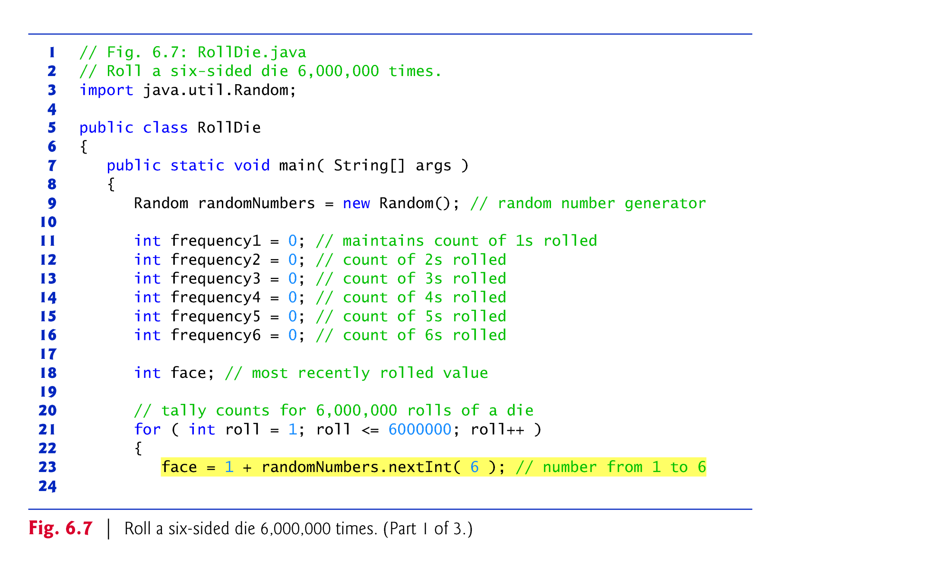

Slide 52
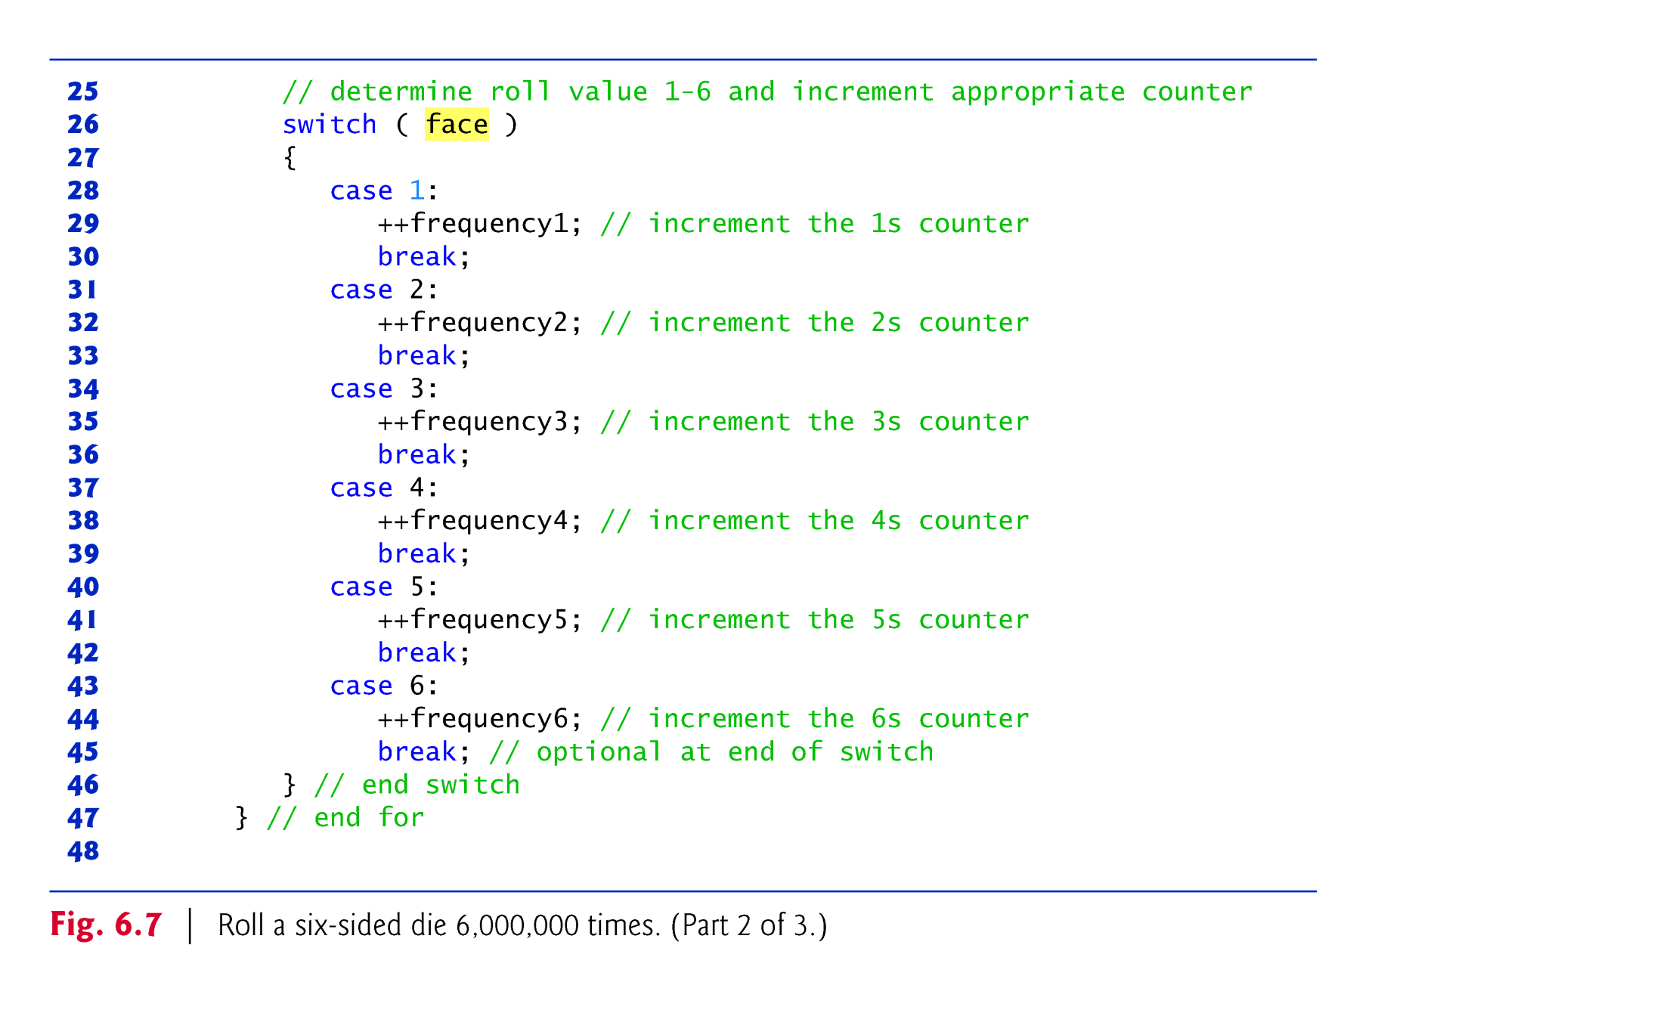

Slide 53
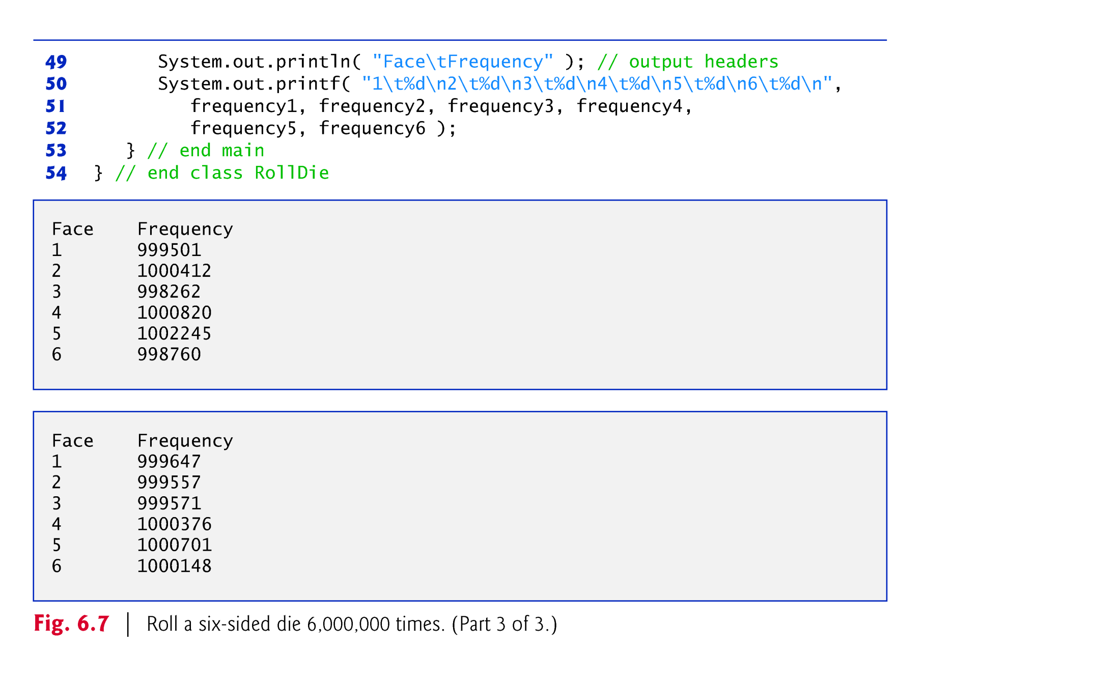

Slide 54

Generalize the scaling and shifting of random numbers:
    number = shiftingValue + randomNumbers.nextInt(scalingFactor);
where shiftingValue specifies the first number in the desired range of consecutive integers and scalingFactor specifies how many numbers are in the range.
It’s also possible to choose integers at random from sets of values other than ranges of consecutive integers:
    number = shiftingValue + differenceBetweenValues *
    randomNumbers.nextInt( scalingFactor );
where shiftingValue specifies the first number in the desired range of values, differenceBetweenValues represents the constant difference between consecutive numbers in the sequence and scalingFactor specifies how many numbers are in the range.
© Copyright 1992-2012 by Pearson Education, Inc. All Rights Reserved.

Slide 55

When debugging an application, it’s sometimes useful to repeat the exact same sequence of pseudorandom numbers.
To do so, create a Random object as follows:
    Random randomNumbers =
    new Random( seedValue );
  seedValue (of type long) seeds the random-number calculation.
You can set a Random object’s seed at any time during program execution by calling the object’s set method.
© Copyright 1992-2012 by Pearson Education, Inc. All Rights Reserved.

Slide 56
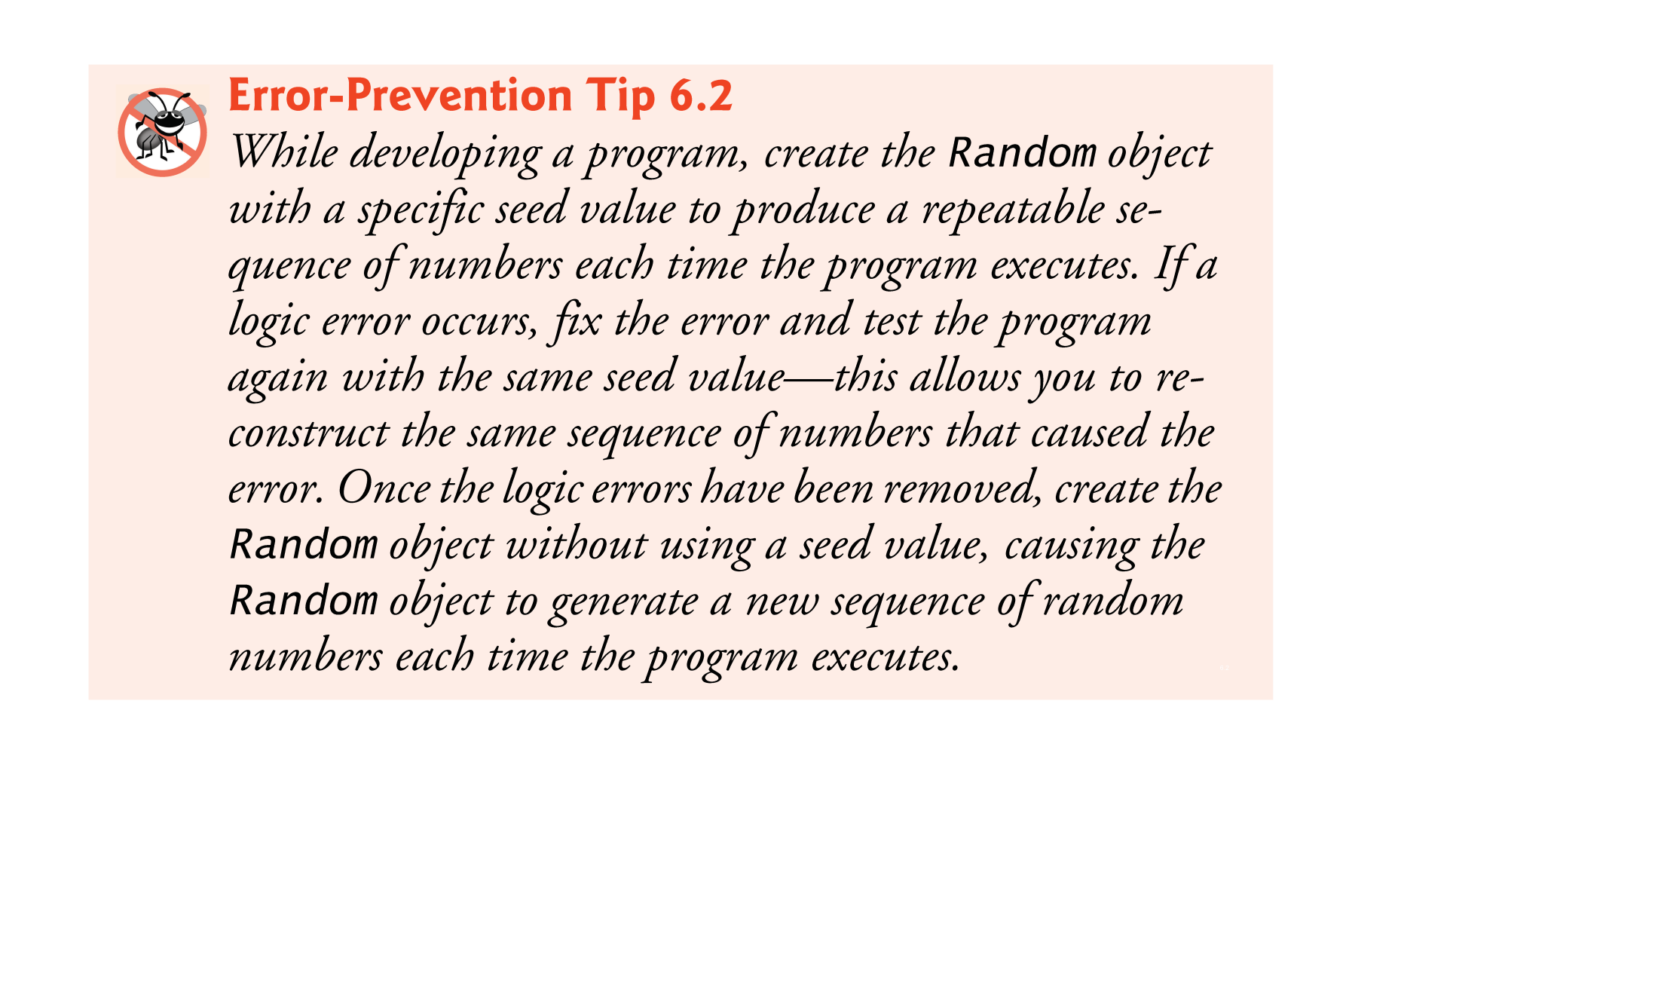
© Copyright 1992-2012 by Pearson Education, Inc. All Rights Reserved.

Slide 57

Basic rules for the dice game Craps:
  You roll two dice. Each die has six faces, which contain one, two, three, four, five and six spots, respectively. After the dice have come to rest, the sum of the spots on the two upward faces is calculated. If the sum is 7 or 11 on the first throw, you win. If the sum is 2, 3 or 12 on the first throw (called “craps”), you lose (i.e., the “house” wins). If the sum is 4, 5, 6, 8, 9 or 10 on the first throw, that sum becomes your “point.” To win, you must continue rolling the dice until you “make your point” (i.e., roll that same point value). You lose by rolling a 7 before making your point.
© Copyright 1992-2012 by Pearson Education, Inc. All Rights Reserved.

Slide 58
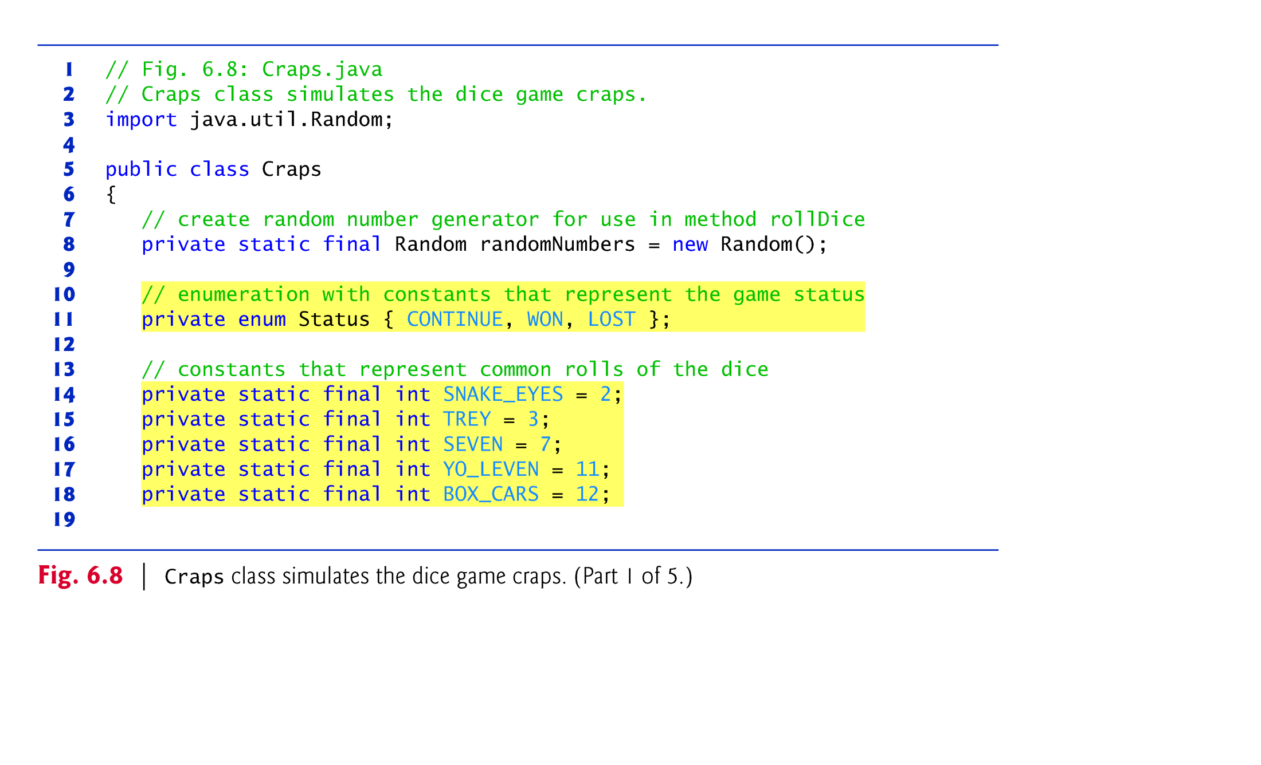

Slide 59
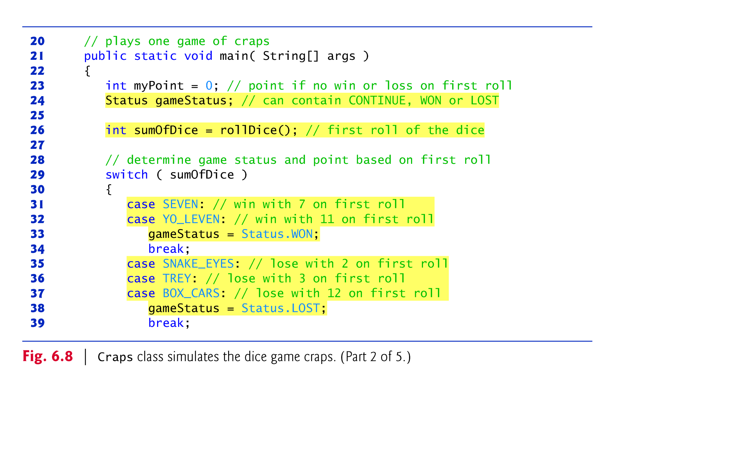

Slide 60
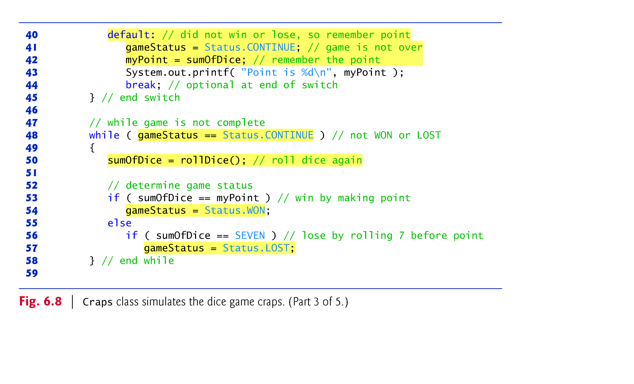

Slide 61
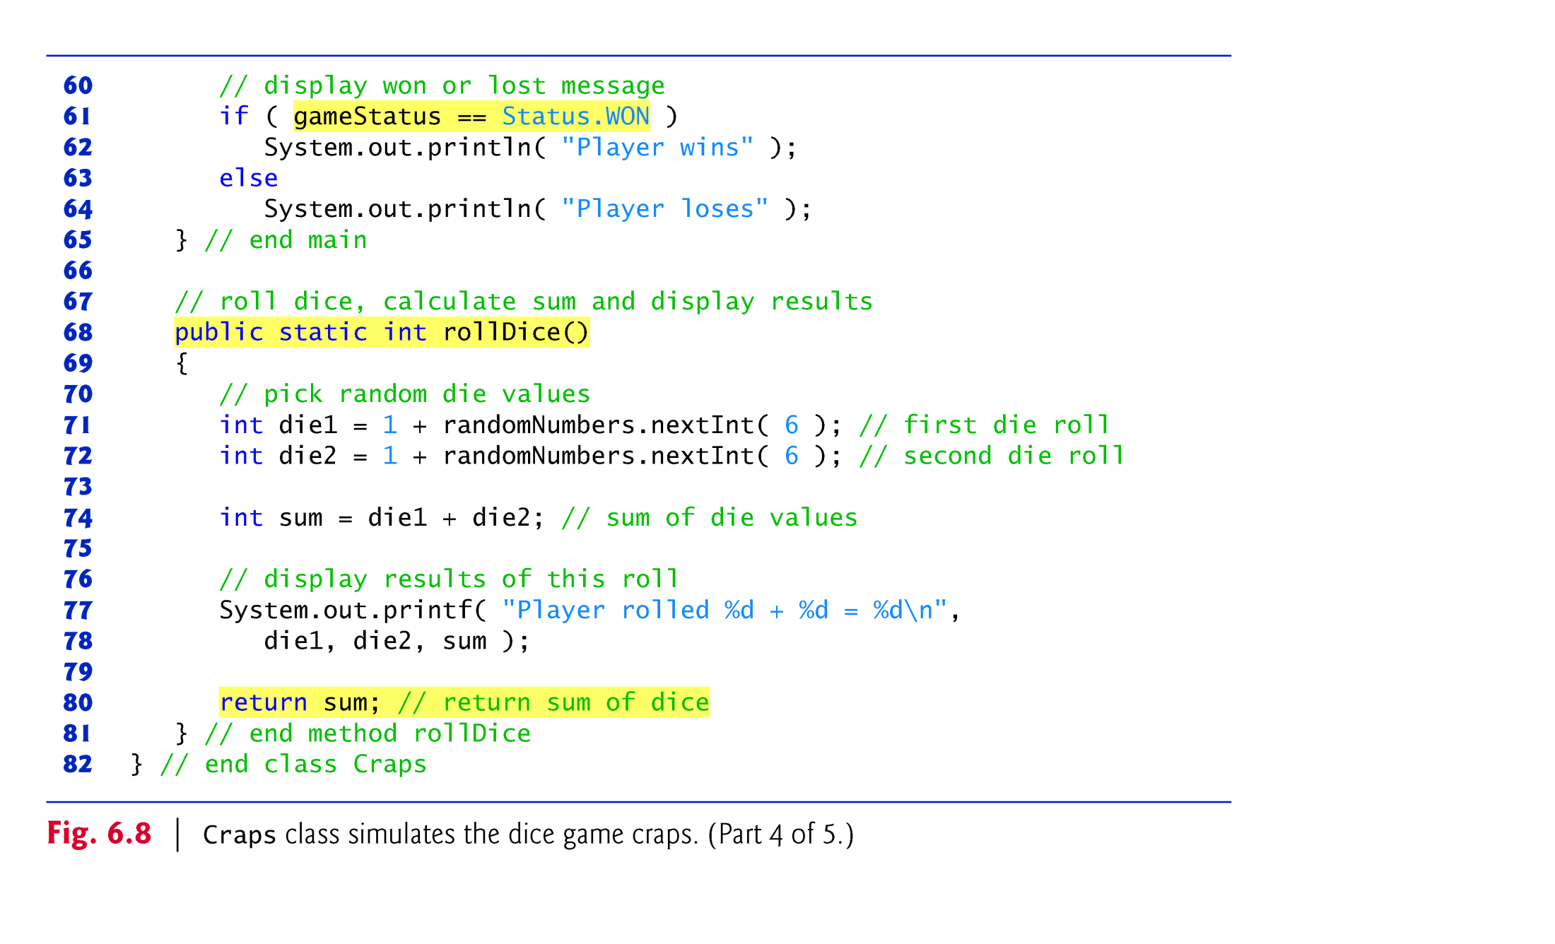

Slide 62
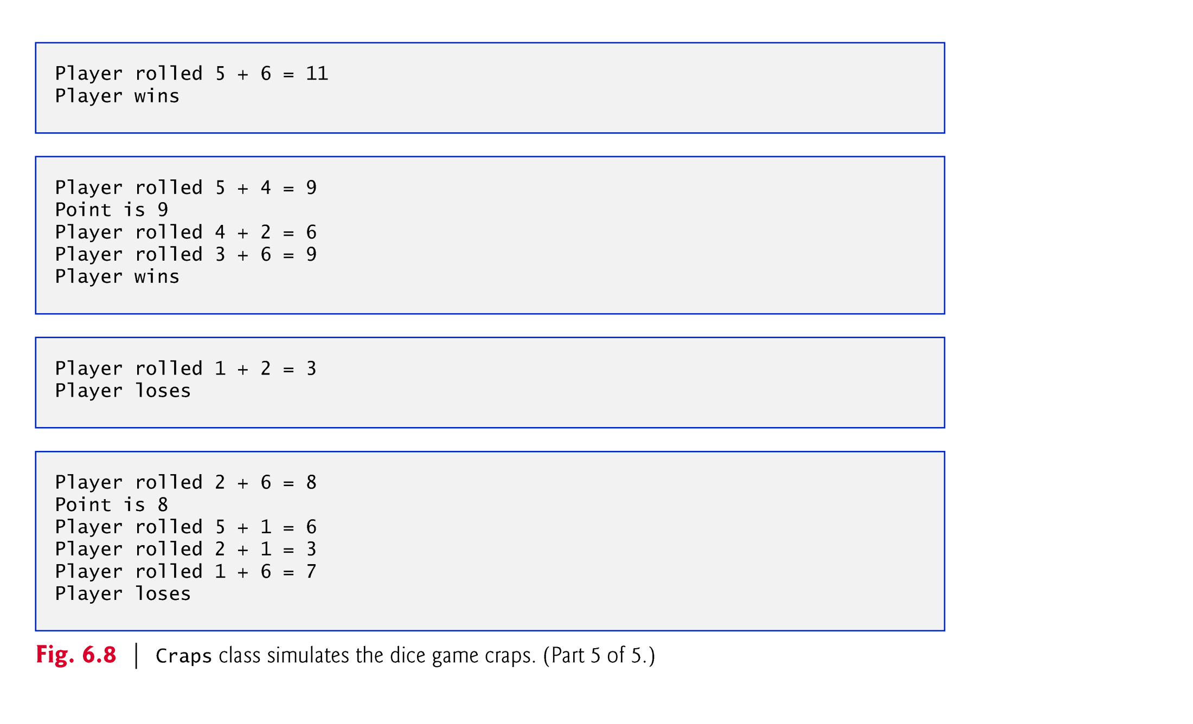

Slide 63

Notes:
  myPoint is initialized to 0 to ensure that the application will compile.
  If you do not initialize myPoint, the compiler issues an error, because myPoint is not assigned a value in every case of the switch statement, and thus the program could try to use myPoint before it is assigned a value.
  gameStatus is assigned a value in every case of the switch statement—thus, it’s guaranteed to be initialized before it’s used and does not need to be initialized.
© Copyright 1992-2012 by Pearson Education, Inc. All Rights Reserved.

Slide 64
enum type Status
  An enumeration in its simplest form declares a set of constants represented by identifiers.
  Special kind of class that is introduced by the keyword enum and a type name.
  Braces delimit an enum declaration’s body.
  Inside the braces is a comma-separated list of enumeration constants, each representing a unique value.
  The identifiers in an enum must be unique.
  Variables of an enum type can be assigned only the constants declared in the enumeration.
© Copyright 1992-2012 by Pearson Education, Inc. All Rights Reserved.

Slide 65


Slide 66

© Copyright 1992-2012 by Pearson Education, Inc. All Rights Reserved.

Slide 67

Colors displayed on computer screens are defined by their red, green, and blue components (called RGB values) that have integer values from 0 to 255.
The higher the value of a component color, the richer that shade will be in the final color.
Java uses class Color in package java.awt to represent colors using their RGB values.
Class Color contains 13 predefined static Color objects—BLACK, BLUE, CYAN, DARK_GRAY, GRAY, GREEN, LIGHT_GRAY, MAGENTA, ORANGE, PINK, RED, WHITE and YELLOW.
© Copyright 1992-2012 by Pearson Education, Inc. All Rights Reserved.

Slide 68
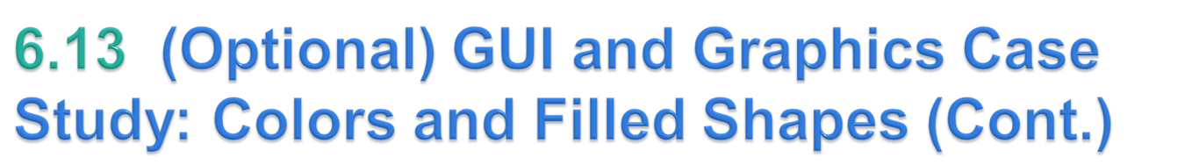
Class Color also contains a constructor of the form:
    public Color( int r, int g, int b )
so you can create custom colors by specifying the red, green and blue component values.
Graphics methods fillRect and fillOval draw filled rectangles and ovals, respectively.
Graphics method setColor sets the current drawing color.
© Copyright 1992-2012 by Pearson Education, Inc. All Rights Reserved.

Slide 69
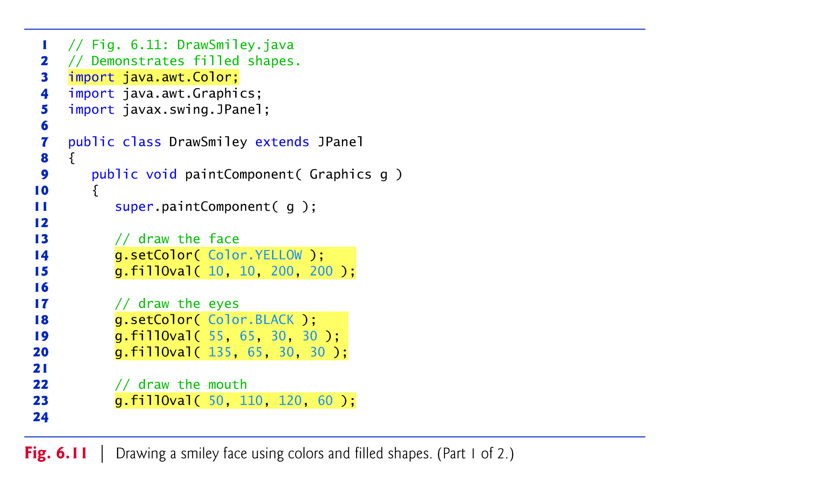

Slide 70
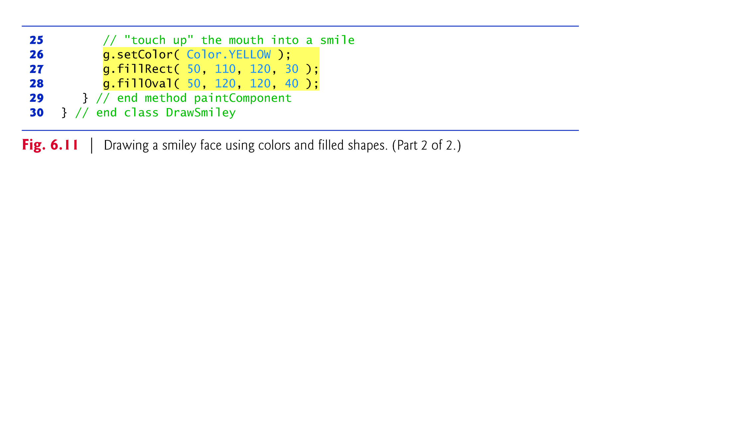

Slide 71
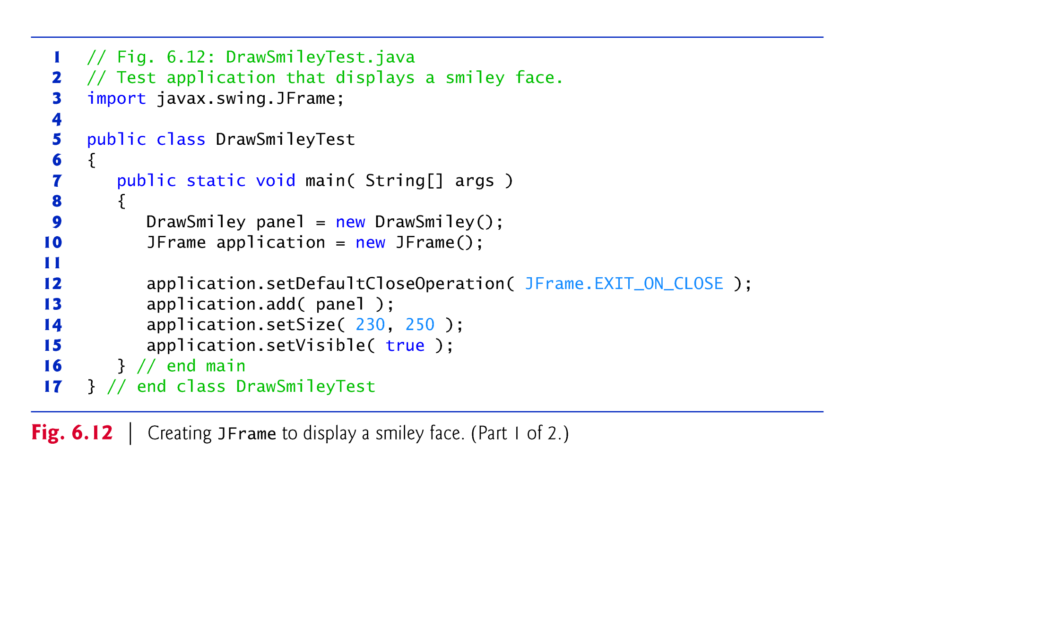

Slide 72
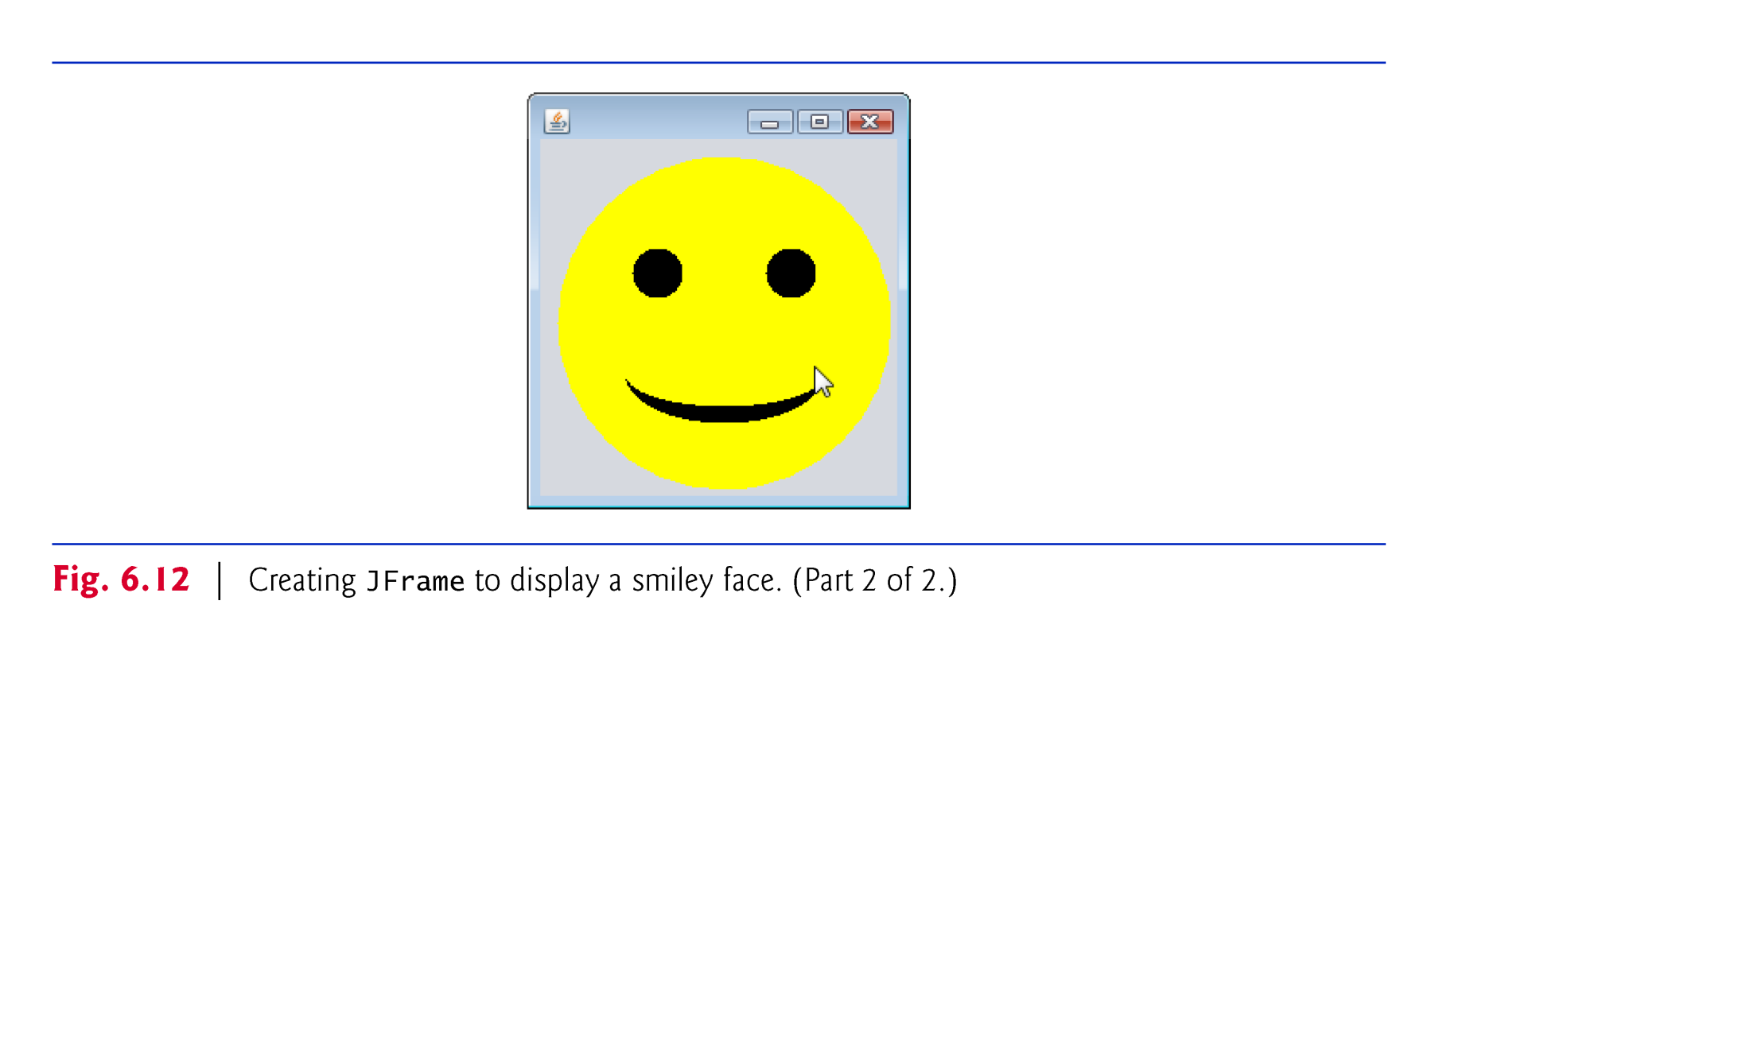

Slide 73
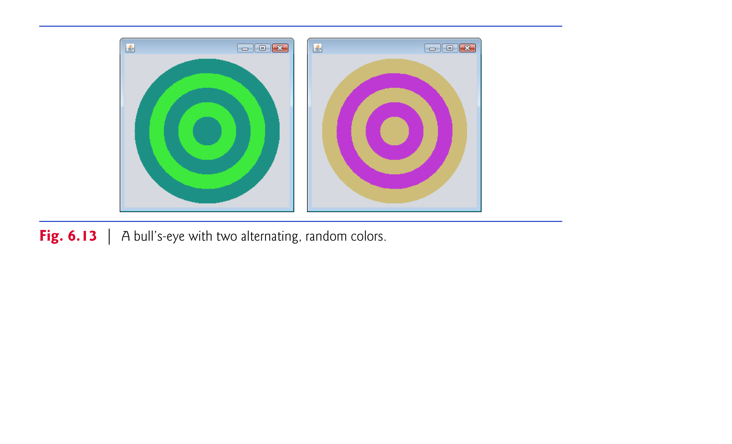

Slide 74
